Slide 1
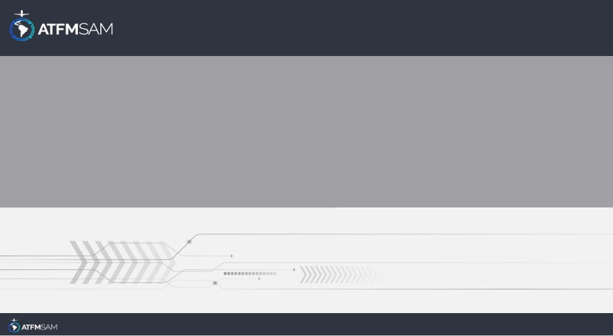
PDA - PERU 22/08/2024

Slide 2
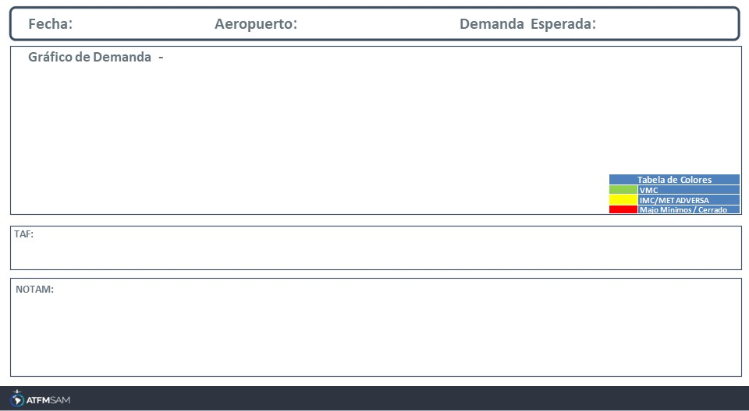
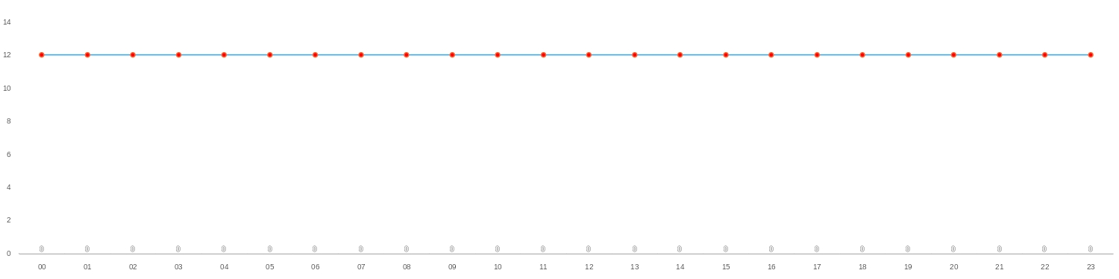
22/08/2024
SPZO
BAJA
Mañana | Tarde | Noche
TAF TAF COR SPZO 211708Z 2118/2218 33005KT 9999 SCT050 TX23/2119Z TN04/2211Z TEMPO 2120/2023 02015KT

Slide 3
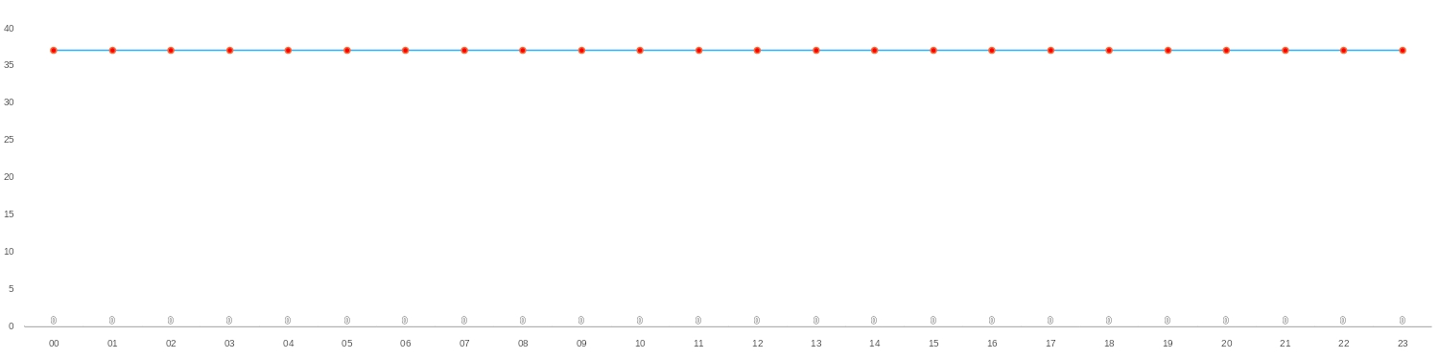
22/08/2024
SPJC
BAJA
Mañana | Tarde | Noche
TAF AMD SPJC 212005Z 2120/2218 17010KT 8000 FEW010 OVC015 TX18/2119Z TN16/2211Z TEMPO 2120/2123 BKN010 OVC015 BECMG 2201/2203 OVC012 TEMPO 2211/2213 30005KT 4500 BR OVC008 BECMG 2215/2217 OVC016
SPJC - REF AIRAC SUP 14/22 IAC RNP RWY 16L -AR- OPR MNM MAKE HAND AMENDMENT AS FOLLOWS: PAG. 11/17 RNP 0.15 OCA/H: 300FT -255FT- MUST BE REPLACED BY 340FT -295FT-, ALS 750M MUST BE REPLACED BY ALS 650M CREATED: 15 Jun 2023 21:57:00 SOURCE: SPIMYNYN start: 2023-06-15T21:57:00.000Z - End: 2100-02-01T00:00:00.000Z

Slide 4
22/08/2024
SPZO
BAJA
Mañana | Tarde | Noche
TAF TAF COR SPZO 211708Z 2118/2218 33005KT 9999 SCT050 TX23/2119Z TN04/2211Z TEMPO 2120/2023 02015KT

Slide 5
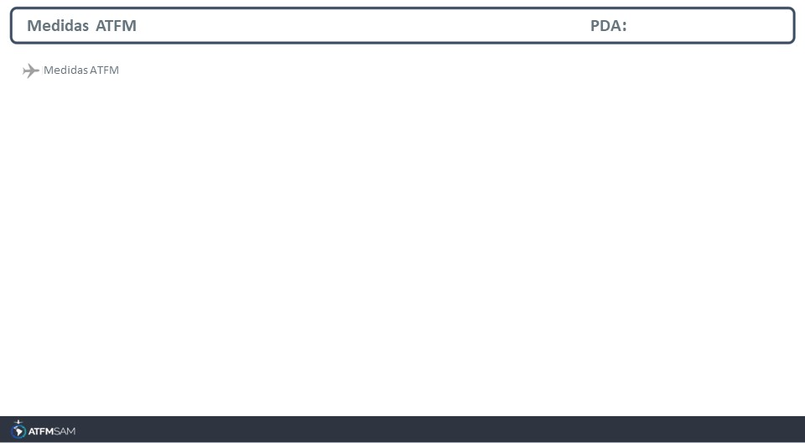
STATE | ORIGIN | DESTINY | ER | START | MEASURE | REASON

Slide 6
