Slide 1

PDA - PERU 12/09/2025

Slide 2
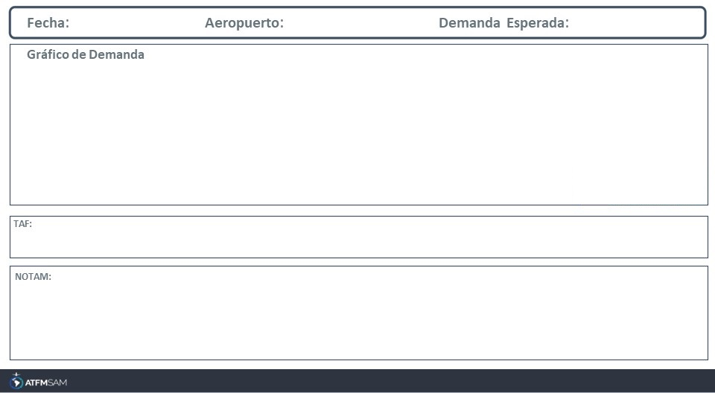
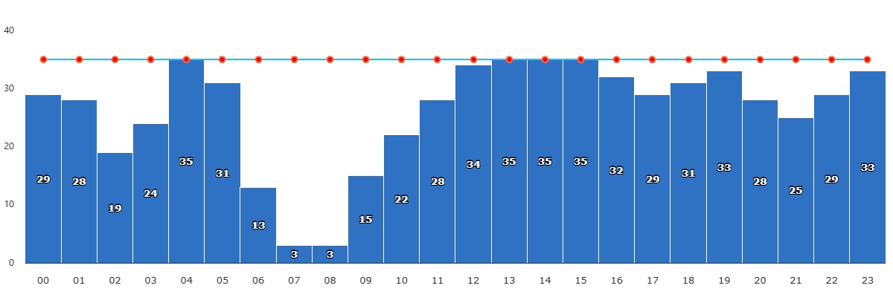
12/09/2025
SPJC
BAJA
VMC
IMC/MET adversa
Majo mínimos / Cerrado

Slide 3
12/09/2025
SPJC
BAJA
VMC
IMC/MET adversa
Majo mínimos / Cerrado

Slide 4
12/09/2025
SPJC
BAJA
VMC
IMC/MET adversa
Majo mínimos / Cerrado

Slide 5
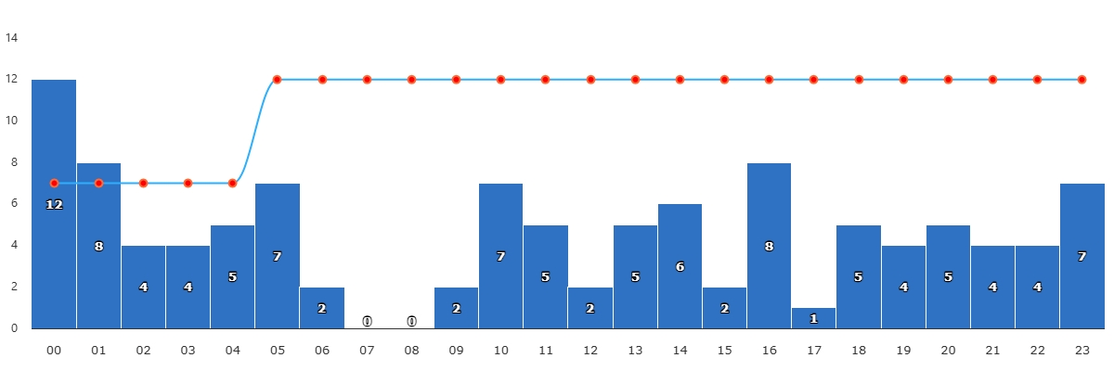
12/09/2025
SPZO
BAJA
VMC
IMC/MET adversa
Majo mínimos / Cerrado

Slide 6
12/09/2025
SPZO
BAJA
VMC
IMC/MET adversa
Majo mínimos / Cerrado

Slide 7
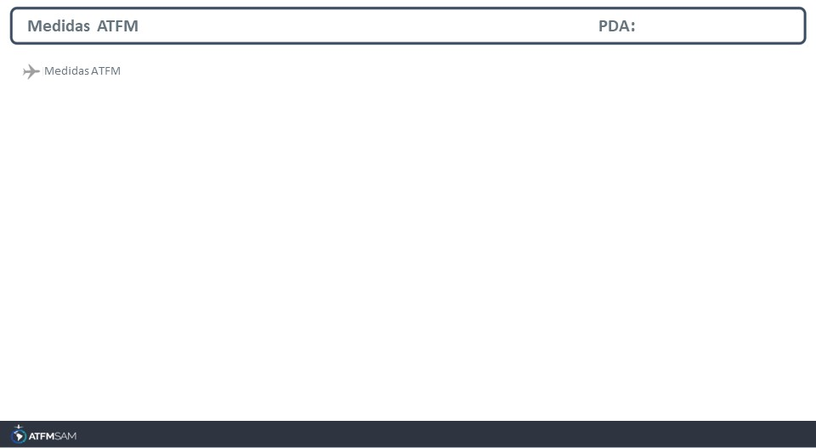
STATE | ORIGIN | DESTINY | ER | START | MEASURE | REASON

Slide 8
