Slide 1
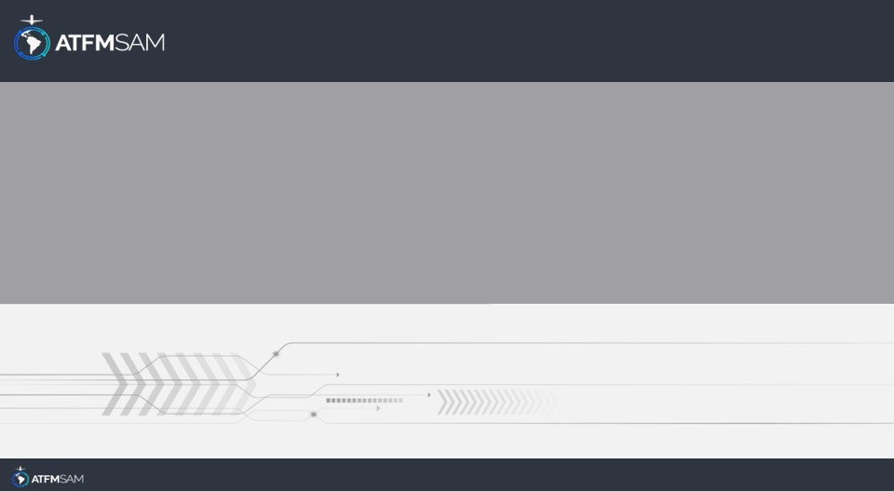
PDA - ECUADOR 23/08/2024

Slide 2
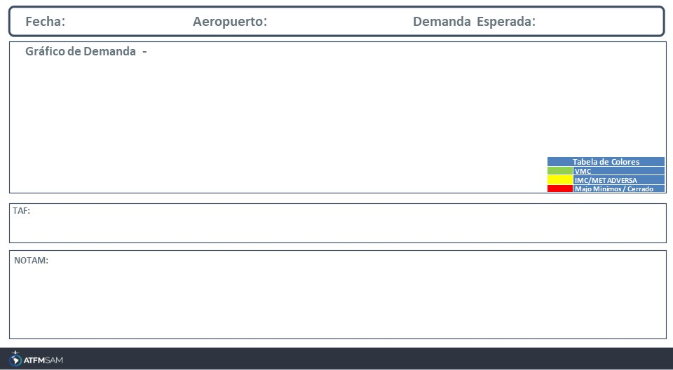
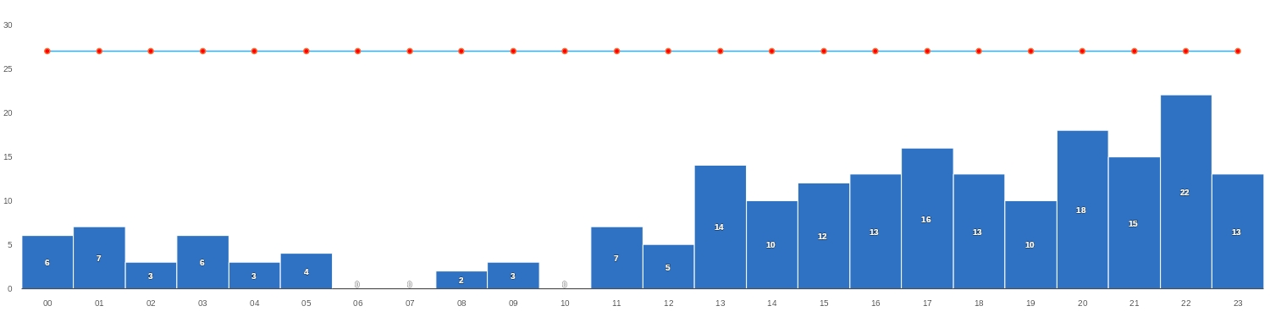
23/08/2024
SEGU
BAJA
Mañana | Tarde | Noche
SEGU 221700Z 2218/2318 23008KT 9999 SCT023 BKN100 TEMPO 2219/2222 15008KT FEW023 BECMG 2304/2306 FEW010 BKN023 BECMG 2313/2315 SCT030 SCT100 TX31/2220Z TN22/2310Z

Slide 3
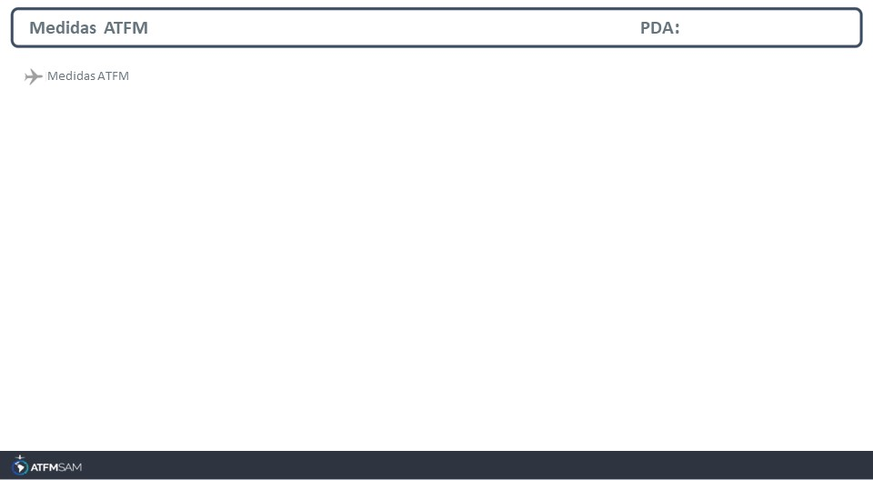
STATE | ORIGIN | DESTINY | ER | START | MEASURE | REASON

Slide 4
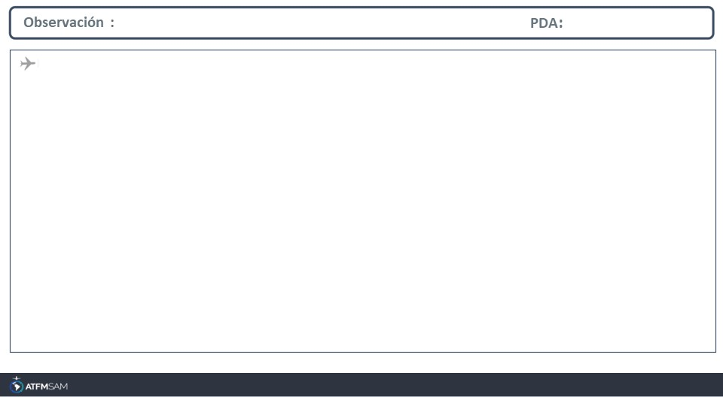
A1326/24 NOTAMN Q)SEFG/QPFCA/I/NBO/E/000/999/0137S08337W999 A)SEFG B)2408010000 C)2408310200 D)DLY 0000-0200 E)FLOW CTL PROC ACT DUE OPERATIONAL REASONS AS FOLLOWS: 05 MIN SEPARATION ALL SOUTHBOUND ACFT ENTERING UTA/FIR GUAYAQUIL, ALL REP REGARLESS F

