Slide 1

PDA - COLOMBIA 12/09/2025

Slide 2
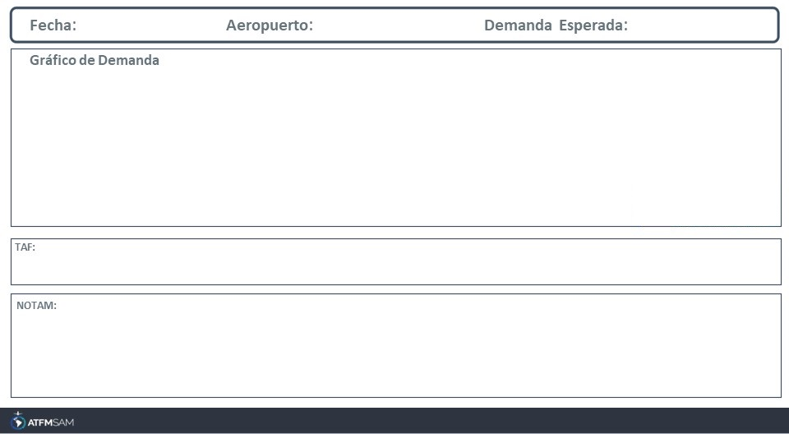
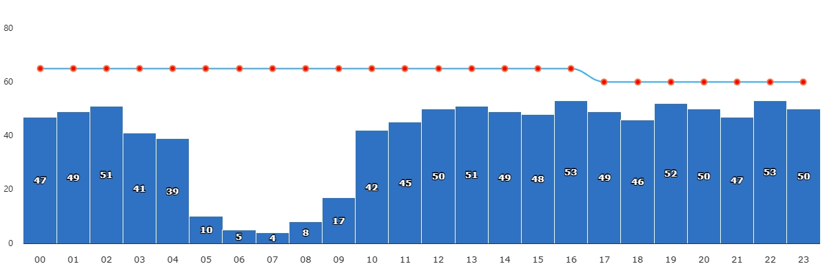
12/09/2025
SKBO
BAJA
VMC
IMC/MET adversa
Majo mínimos / Cerrado
TAF SKBO 111655Z 1118/1218 14010KT 9999 SCT030 PROB30 TEMPO 1119/1123 24009KT VCSH TX19/1119Z TN10/1210Z
SKBO - ILS IEDR RWY 14L U/S CREATED: 05 Jul 2025 11:51:00 SOURCE: SKBOYNYX start: 2025-07-05T11:49:00.000Z - End: 2025-10-02T23:59:00.000Z SKBO - IAP ILS X RWY 14R CAT II AND CAT III U/S CREATED: 09 Jul 2025 03:41:00 SOURCE: SKBOYNYX start: 2025-07-09T03:39:00.000Z - End: 2025-10-06T23:59:00.000Z

Slide 3
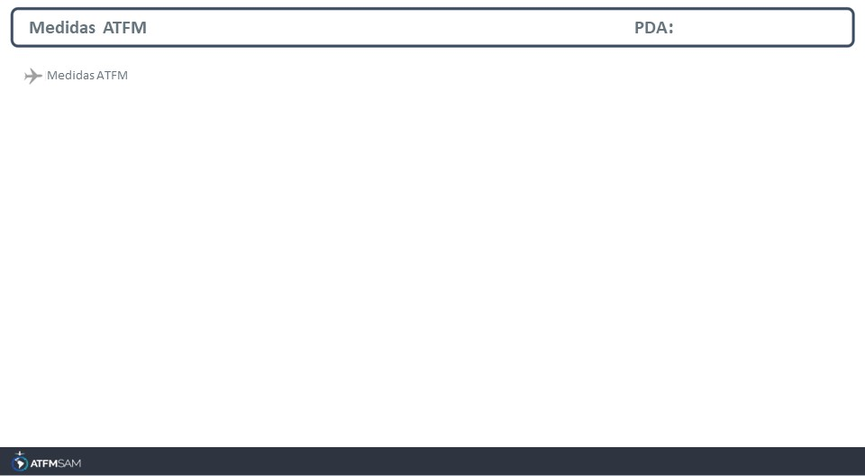
STATE | ORIGIN | DESTINY | ER | START | MEASURE | REASON
COLOMBIA |  | SKBO | SKBO | 12/09/2025 - 10:00 |  | VOLUMEN DE TRÁFICO

Slide 4
