Slide 1
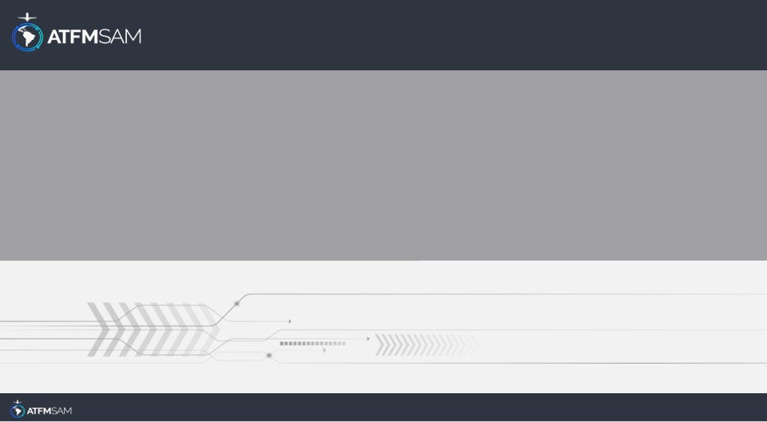
PDA - CHILE 28/06/2025

Slide 2
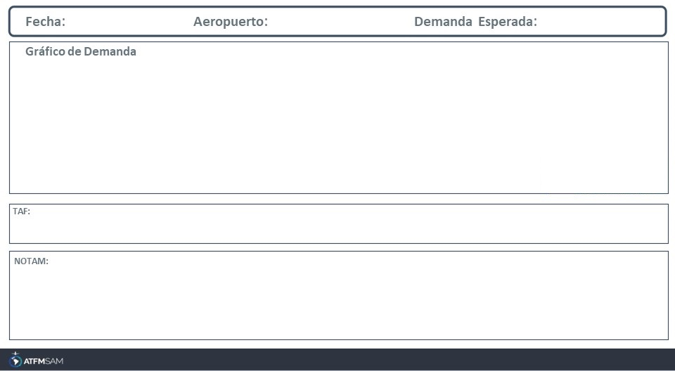
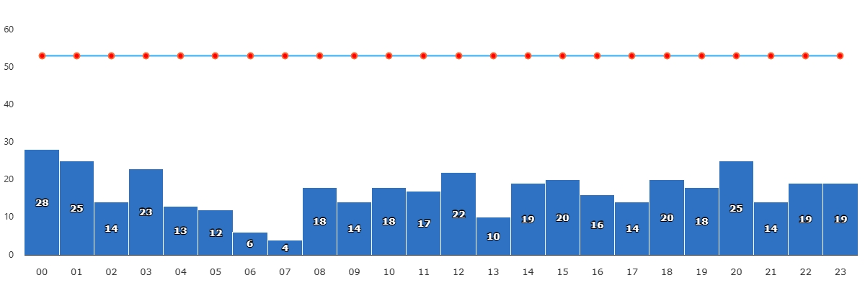
28/06/2025
SCEL
BAJA
VMC
IMC/MET adversa
Majo mínimos / Cerrado
TAF SCEL 271000Z 2712/2812 VRB02KT 1500 BR NSC TX13/2719Z TN05/2810Z TEMPO 2712/2714 0550 FG BECMG 2714/2716 4000 BR BECMG 2716/2718 19010KT 8000 NSW BECMG 2800/2802 15004KT BKN180 BECMG 2803/2805 SCT060 BKN180

Slide 3
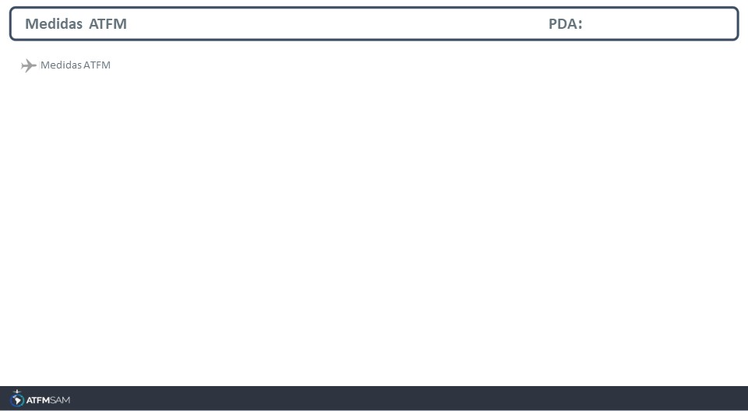
STATE | ORIGIN | DESTINY | ER | START | MEASURE | REASON
CHILE | SAMF | SCEZ | SCEZ | 28/06/2025 - 00:00 | 00:03:00 | VOLUME DE TRÁFEGO

Slide 4
