Slide 1
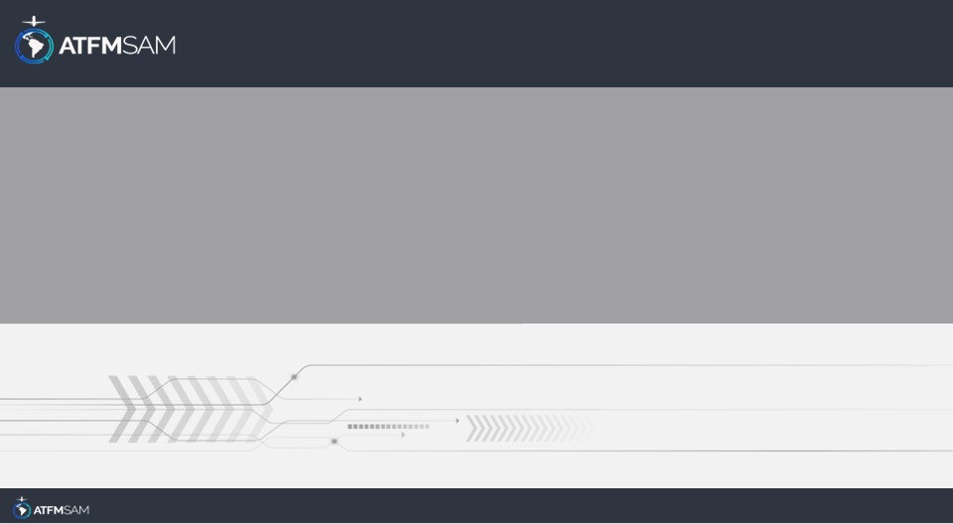
PDA - CHILE
26/09/2024

Slide 2
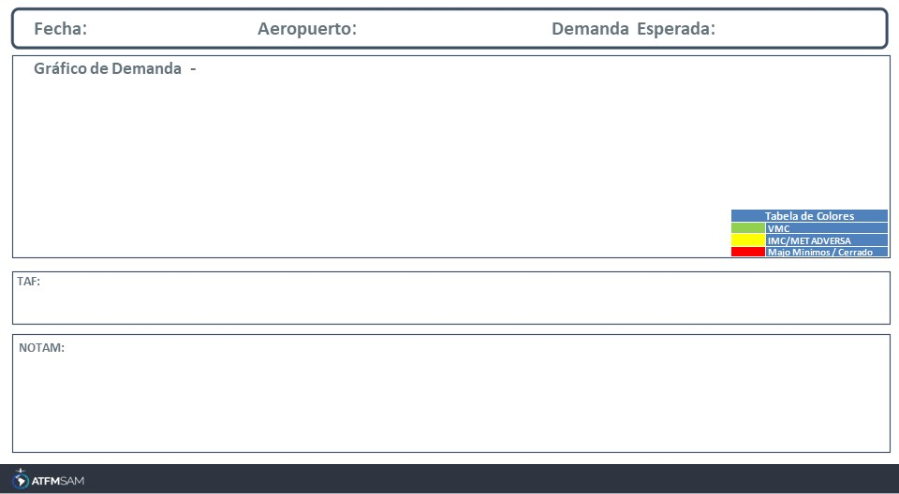
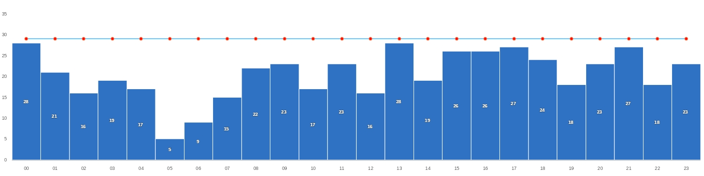
26/09/2024
SCEL
BAJA
Mañana | Tarde | Noche
TAF SCEL 251000Z 2512/2612 20007KT CAVOK TX20/2519Z TN04/2610Z BECMG 2515/2517 19010KT BECMG 2601/2603 17003KT BECMG 2608/2610 6000

Slide 3
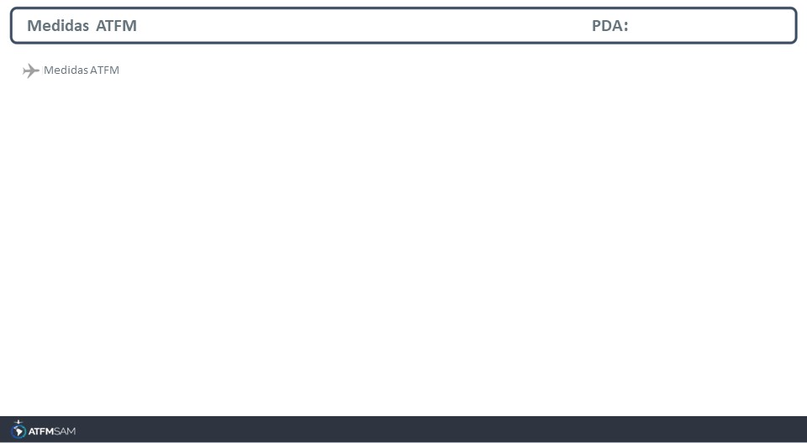
STATE | ORIGIN | DESTINY | ER | START | MEASURE | REASON

Slide 4
