Slide 1
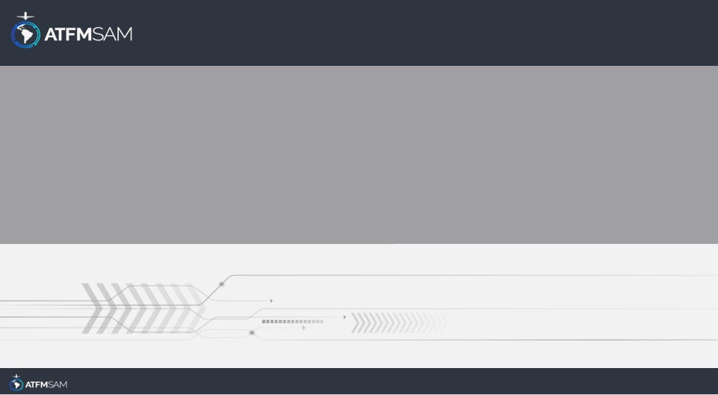
PDA - CHILE 25/09/2024

Slide 2
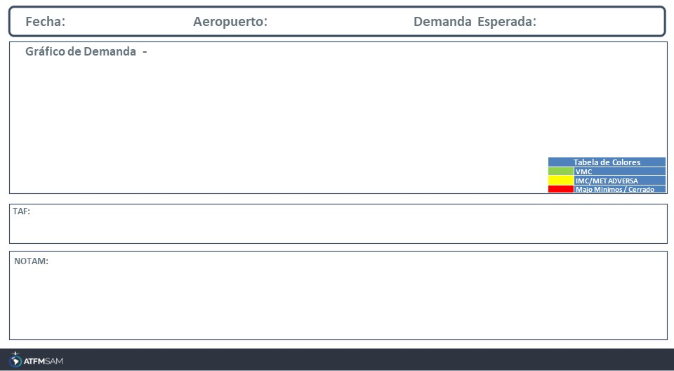
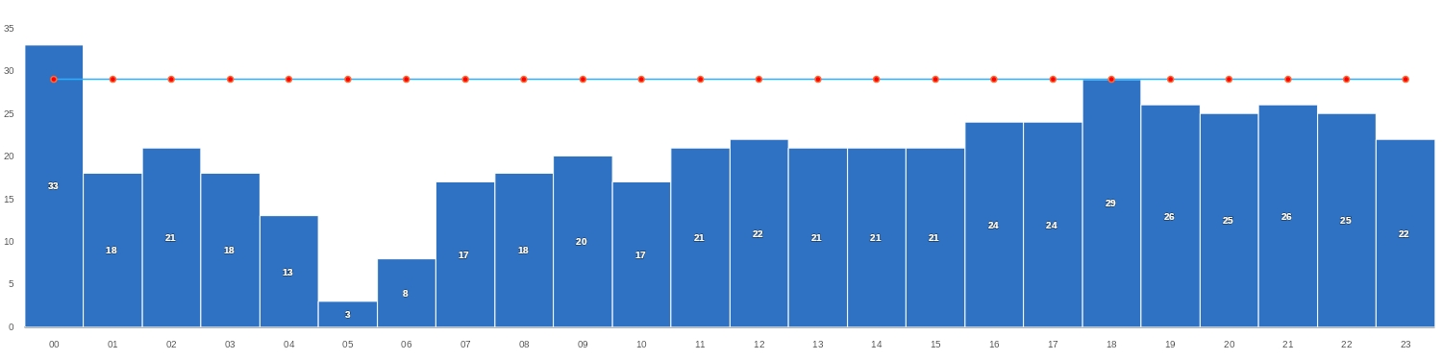
25/09/2024
SCEL
BAJA
Mañana | Tarde | Noche
TAF SCEL 241000Z 2412/2512 15004KT 8000 NSC TX18/2419Z TN04/2510Z TEMPO 2412/2413 3000 BR BECMG 2414/2416 19010KT BECMG 2502/2504 15004KT TEMPO 2508/2512 5000 HZ

Slide 3
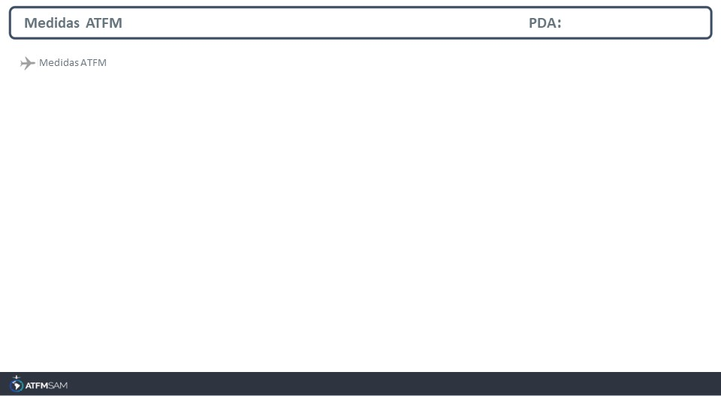
STATE | ORIGIN | DESTINY | ER | START | MEASURE | REASON

Slide 4
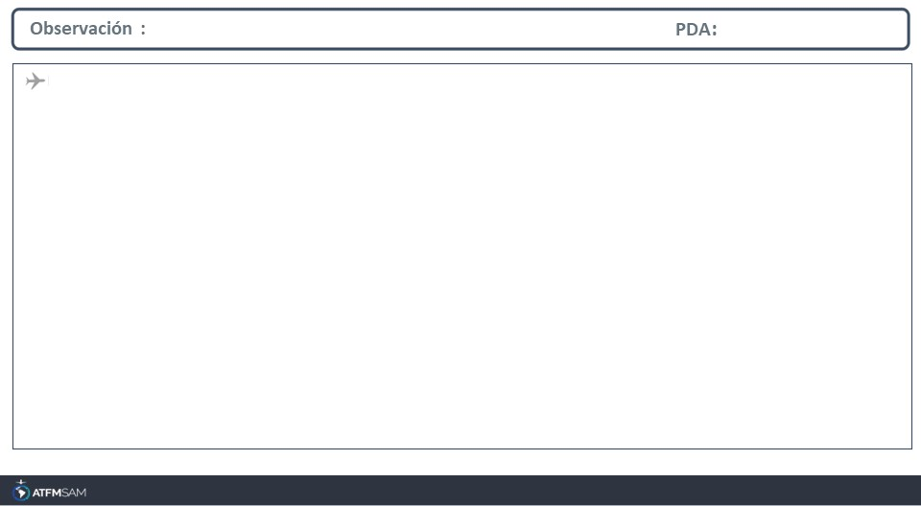
A2885/24 NOTAMN Q)SCEZ/QFALT/IV/NBO/AE/000/999/3324S07048W005 A)SCEL B)2409080000 C)2409302359 E)POSS DELAY UPON ARRIVALS AND DEPARTURES DUE TO RWY USE RESTRICTIONS

