Slide 1
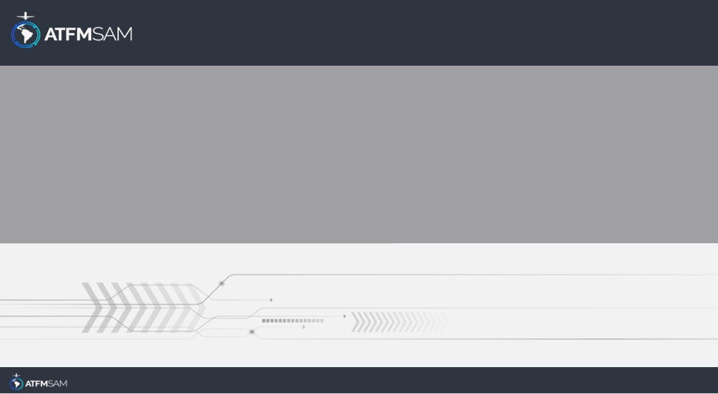
PDA - CHILE 26/07/2024

Slide 2
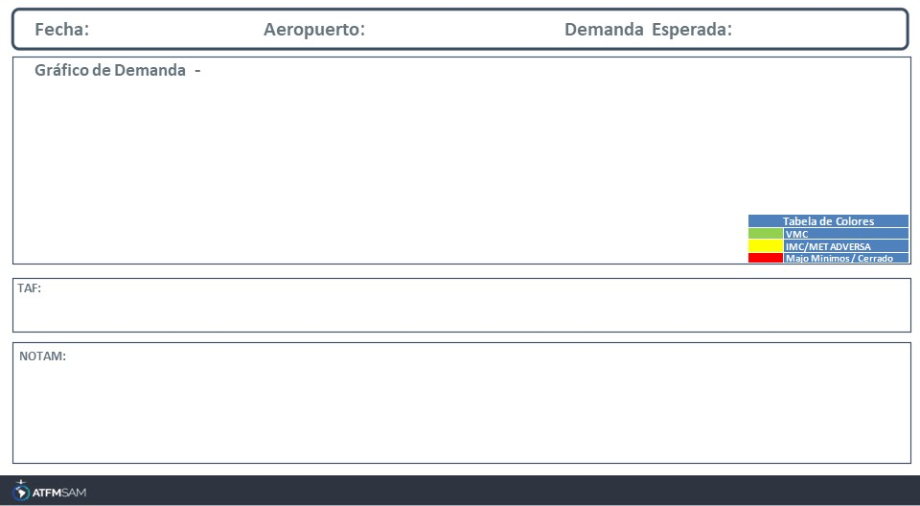
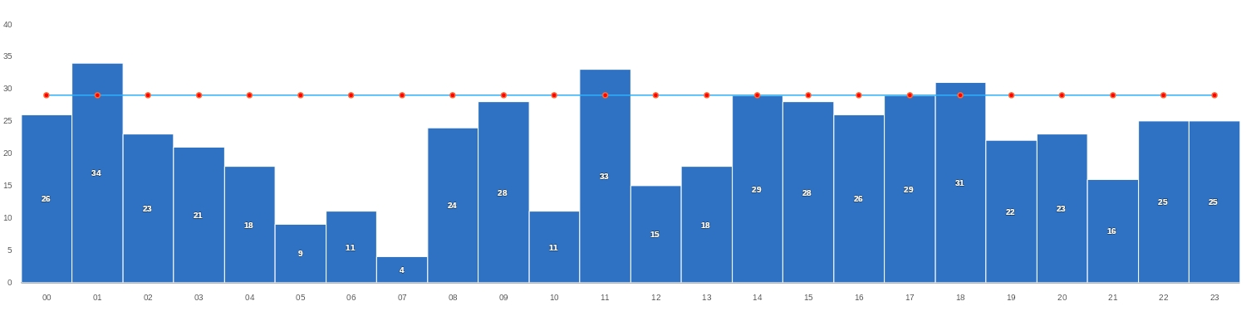
26/07/2024
SCEL
Baixa
Mañana | Tarde | Noche
TAF SCEL 251000Z 2512/2612 15004KT 8000 NSC TX18/2519Z TN04/2610Z TEMPO 2512/2514 VRB02KT 5000 HZ BECMG 2517/2519 18008KT TEMPO 2520/2600 SCT160 BECMG 2602/2604 30004KT 7000 BECMG 2604/2606 4000 BR TEMPO 2606/2612 VRB02KT 0500 FG SCT002

Slide 3
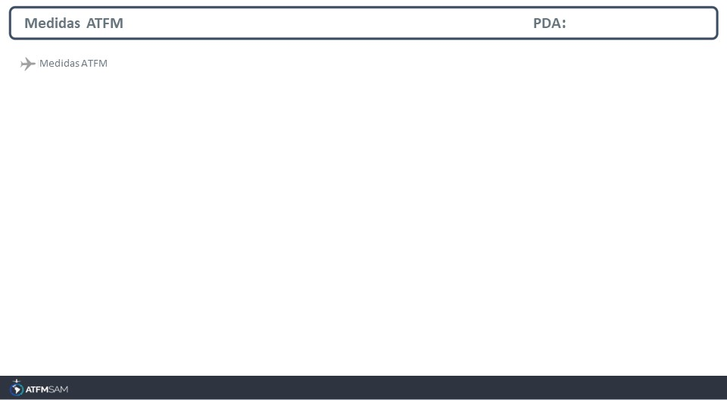
STATE | ORIGIN | DESTINY | ER | START | MEASURE | REASON

Slide 4
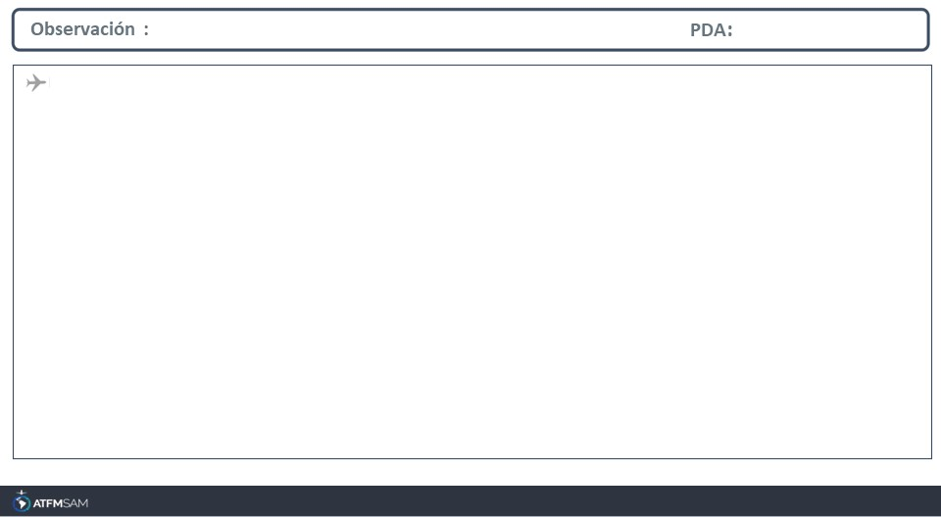
FMU-CHILE Avda. San Pablo 8381, Pudahuel. Santiago -Chile EMAIL: fmu-chile@dgac.gob.cl AMHS: SCLPATFM -SCLPFMUA REDDIG ADM: 404034 -404793 REDDIG ATS: 4014 Tel: ( 56 2) 2 4392000 extensión 4034-4793

