Slide 1
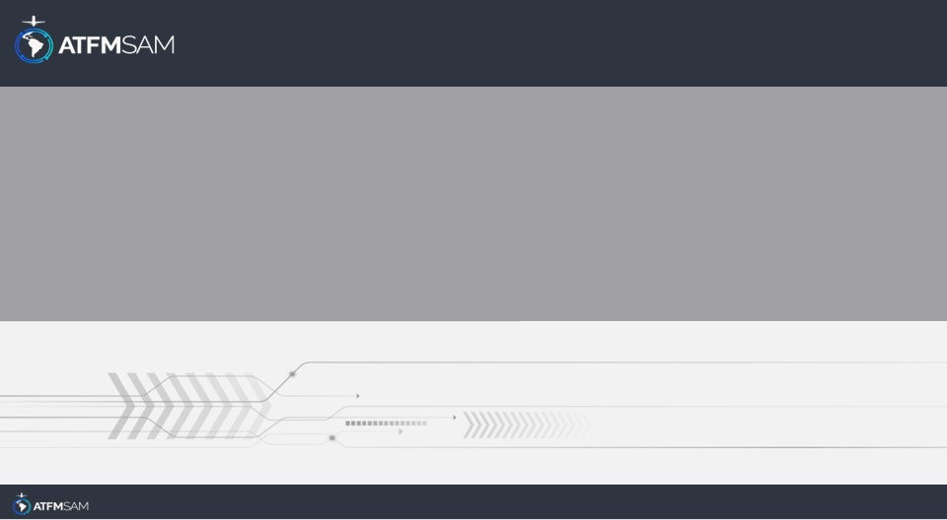
PDA - CHILE
24/09/2024

Slide 2
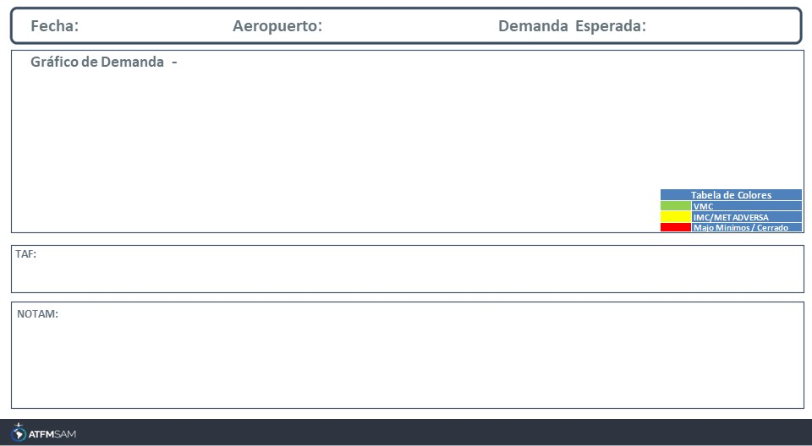
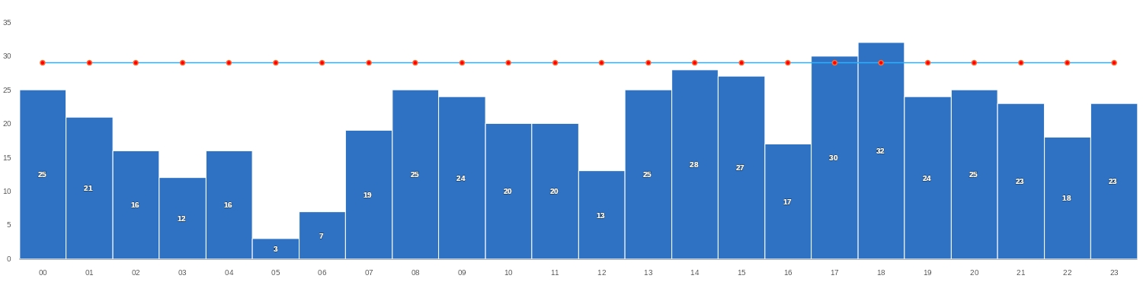
24/09/2024
SCEL
BAJA
Mañana | Tarde | Noche
TAF SCEL 231600Z 2318/2418 18010KT 9999 SCT080 BKN160 TX16/2319Z TN03/2410Z BECMG 2321/2323 FEW050 BKN100 OVC140 BECMG 2400/2402 VRB02KT BKN150 TEMPO 2408/2412 5000 BR BKN008 BECMG 2414/2416 18005KT SCT035

Slide 3
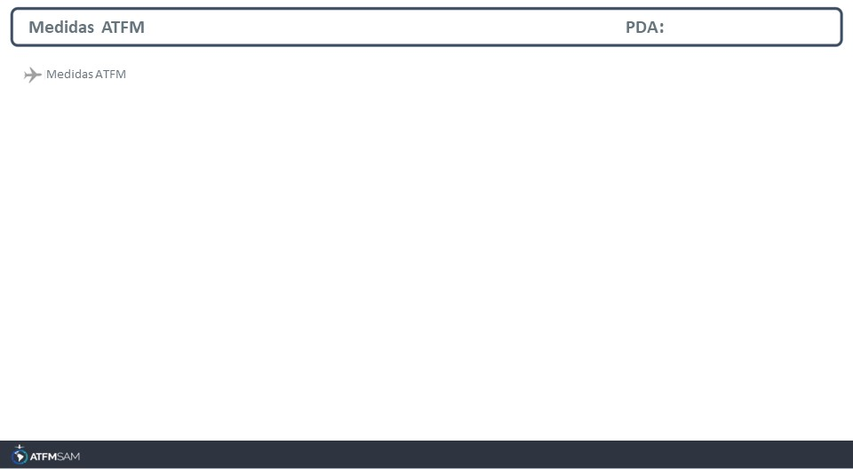
STATE | ORIGIN | DESTINY | ER | START | MEASURE | REASON

Slide 4
