Slide 1
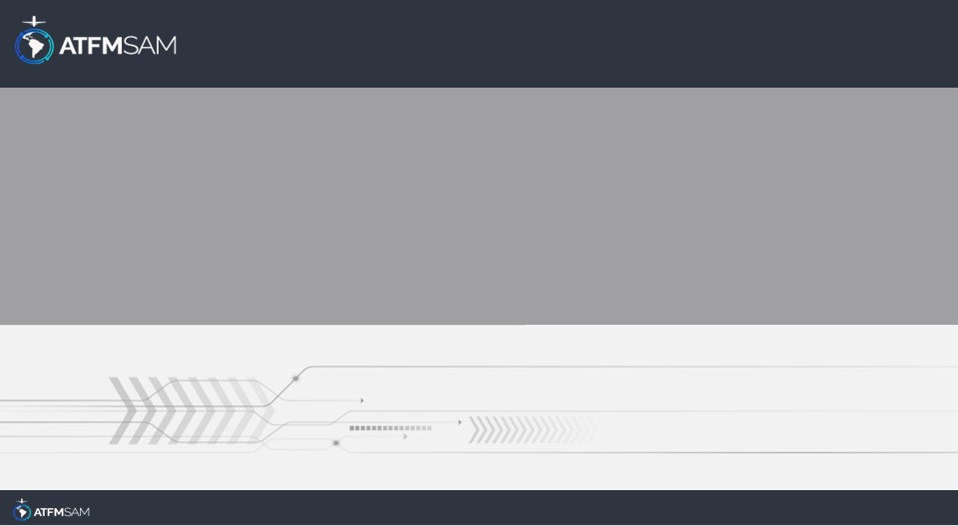
PDA - CHILE 24/01/2026

Slide 2
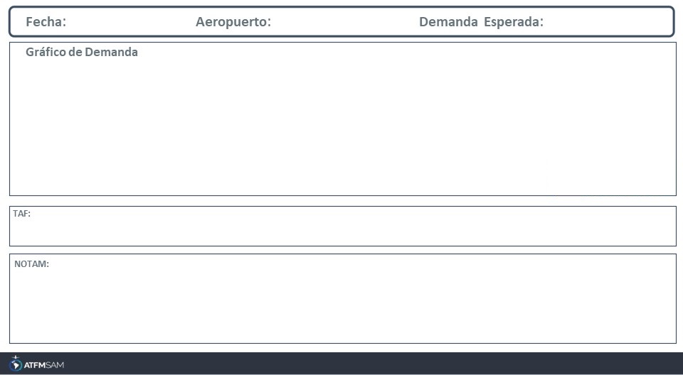
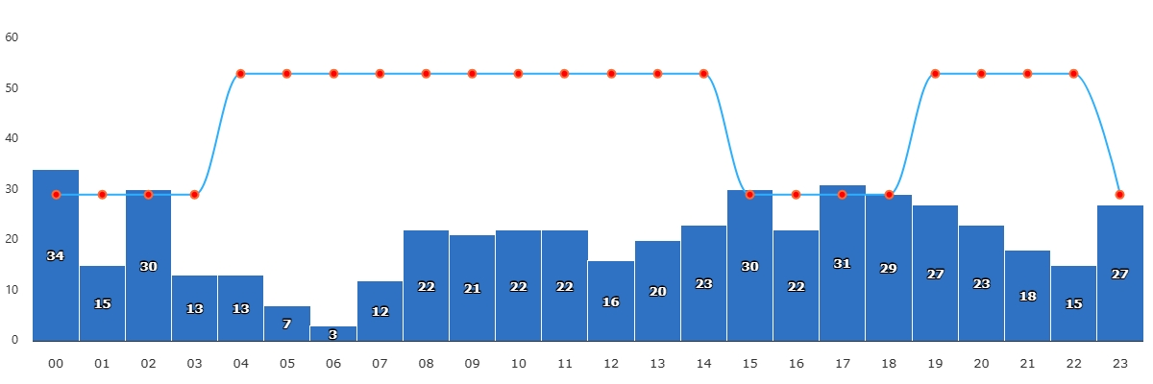
24/01/2026
SCEL
BAJA
VMC
IMC/MET adversa
Majo mínimos / Cerrado
TAF SCEL 231611Z 2318/2418 21013KT CAVOK TX32/2319Z TN17/2409Z BECMG 2401/2403 15007KT TEMPO 2411/2414 VRB02KT

Slide 3
24/01/2026
SCEL
BAJA
VMC
IMC/MET adversa
Majo mínimos / Cerrado
TAF SCEL 231611Z 2318/2418 21013KT CAVOK TX32/2319Z TN17/2409Z BECMG 2401/2403 15007KT TEMPO 2411/2414 VRB02KT

Slide 4
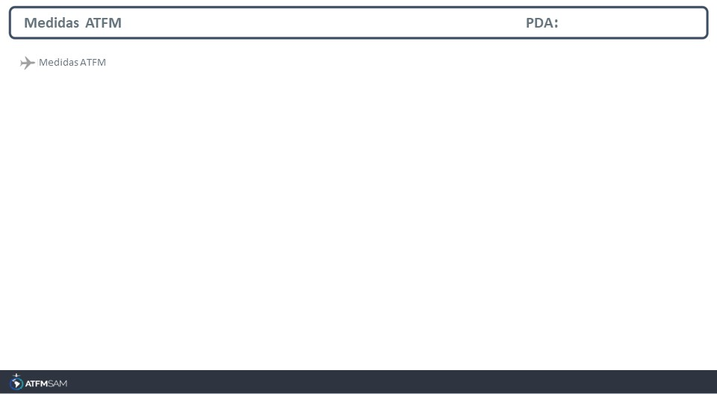
STATE | ORIGIN | DESTINY | ER | START | MEASURE | REASON

Slide 5
