Slide 1
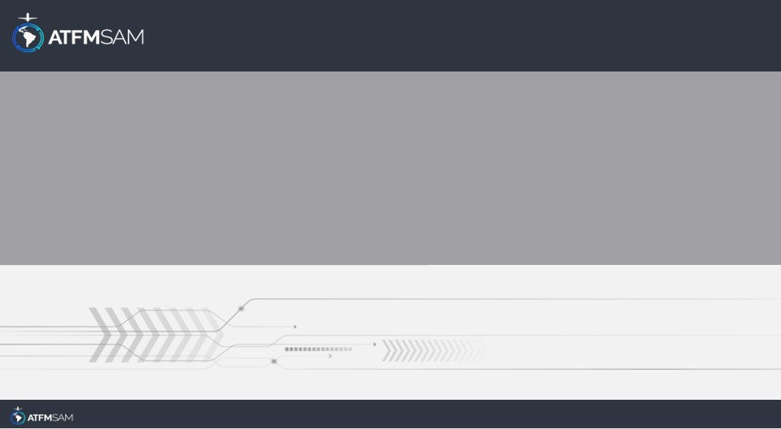
PDA - CHILE 20/07/2024

Slide 2
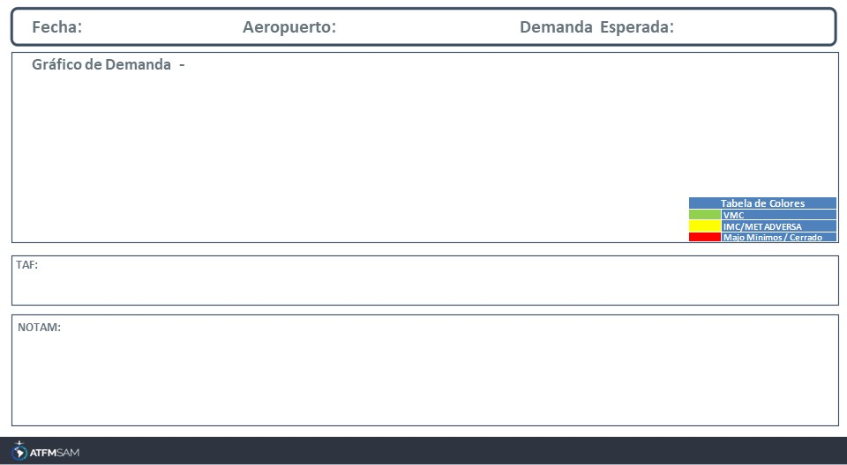
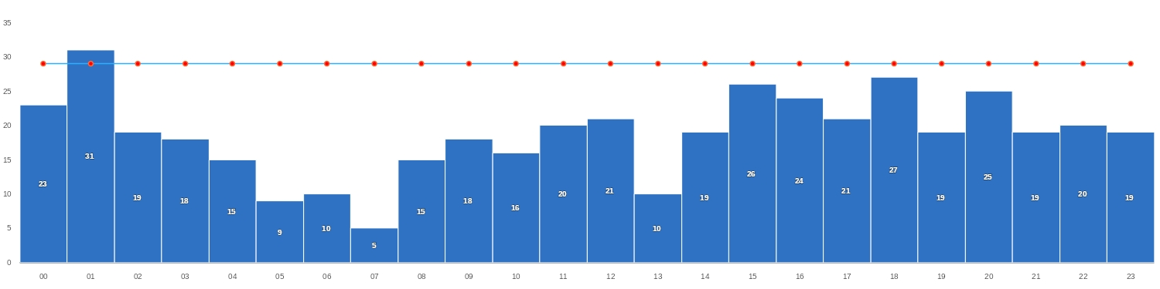
20/07/2024
SCEL
Baixa
Mañana | Tarde | Noche
TAF SCEL 191000Z 1912/2012 15003KT 6000 BKN170 TX15/1919Z TN05/2010Z BECMG 1913/1915 FEW160 BKN200 BECMG 1916/1918 21008KT 8000 NSC BECMG 2001/2003 15004KT
SCEL - RWY 17L/35R INCREASED BIRD HAZARD (MODERATE TO SEVERE) start: 2024-04-25T16:16:00.000Z - End: 2024-07-26T12:30:00.000Z SCEL - DECLARED CAPACITY OF RWY 17L/17R ACCORDING TO REF AIP CHILE VOL I PAGE ENR 1.9-15 BY DISPLACED THR 17R TEMPO RWY18 AIP VOL II SUP AIP S04/24. CREATED: 15 Apr 2024 23:16:00 SOURCE: SCSCYNYX start: 2024-04-29T13:00:00.000Z - End: 2024-07-29T23:59:00.000Z SCEL - THR 17R DISPLACED BY WIP, ESTABLISHING A NEW TEMPO THR 18. FOR PHYSICAL CHARACTERISTICS OF THE RWY, NEW APCH TO RWY 18 AND DURATION OF THE WIP SEE SUP AIP S04/2024 CREATED: 11 Apr 2024 14:33:00 SOURCE: SCSCYNYX start: 2024-04-29T13:00:00.000Z - End: 2024-07-29T23:59:00.000Z SCEL - POSS DELAY UPON ARRIVALS AND DEPARTURES DUE TO RWY USE RESTRICTIONS CREATED: 29 Apr 2024 18:30:00 SOURCE: SCSCYNYX start: 2024-04-30T00:00:00.000Z - End: 2024-07-29T23:59:00.000Z

Slide 3
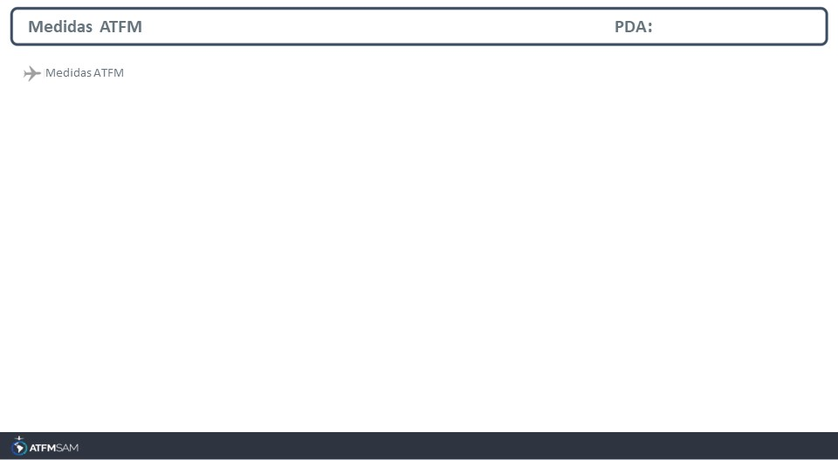
STATE | ORIGIN | DESTINY | ER | START | MEASURE | REASON

Slide 4
