Slide 1

PDA - CHILE 19/06/2025

Slide 2
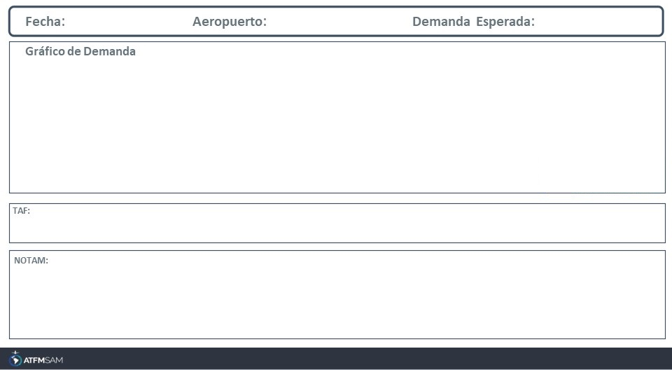
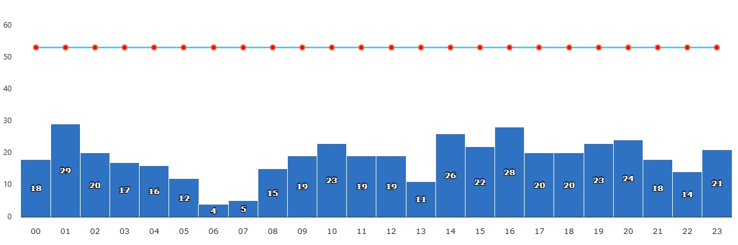
19/06/2025
SCEL
BAJA
VMC
IMC/MET adversa
Majo mínimos / Cerrado
TAF SCEL 181023Z 1812/1912 VRB02KT 2000 BR NSC TX14/1819Z TN01/1910Z TEMPO 1812/1815 0700 BCFG BECMG 1815/1817 5000 HZ BECMG 1818/1820 CAVOK BECMG 1902/1904 33004KT 7000 TEMPO 1908/1912 5000 HZ

Slide 3
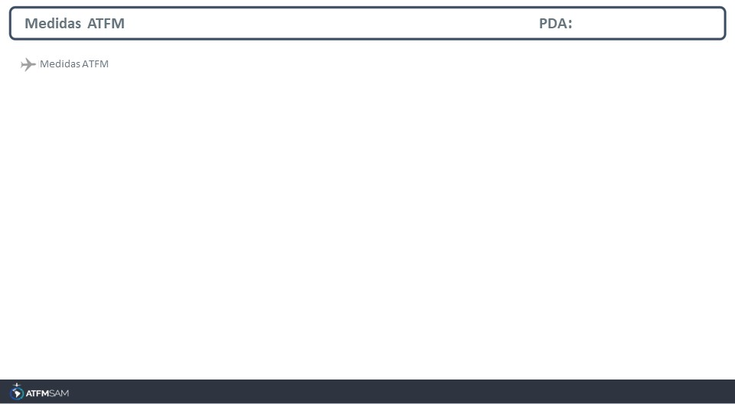
STATE | ORIGIN | DESTINY | ER | START | MEASURE | REASON

Slide 4
