Slide 1
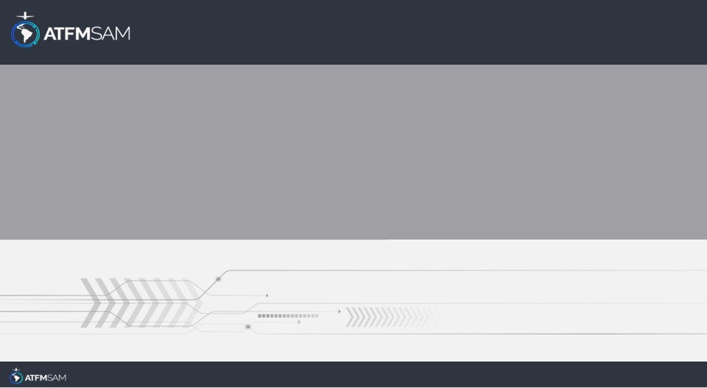
PDA - CHILE
18/07/2024

Slide 2
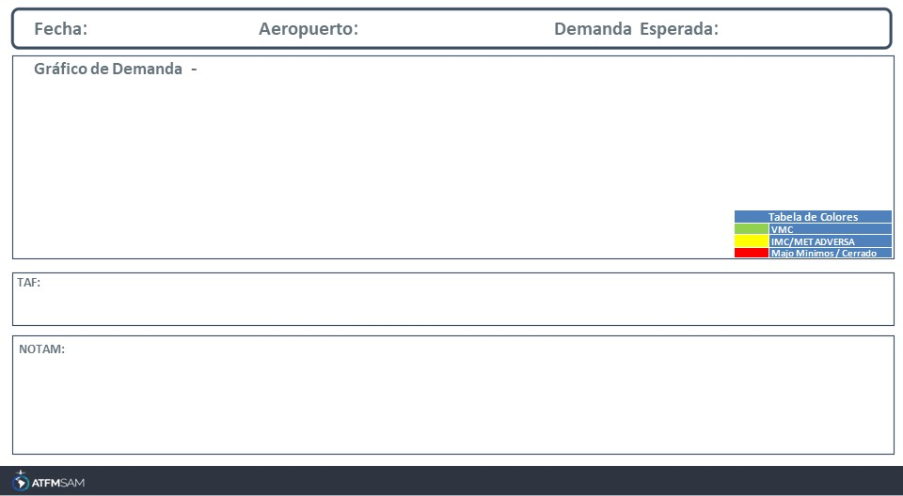
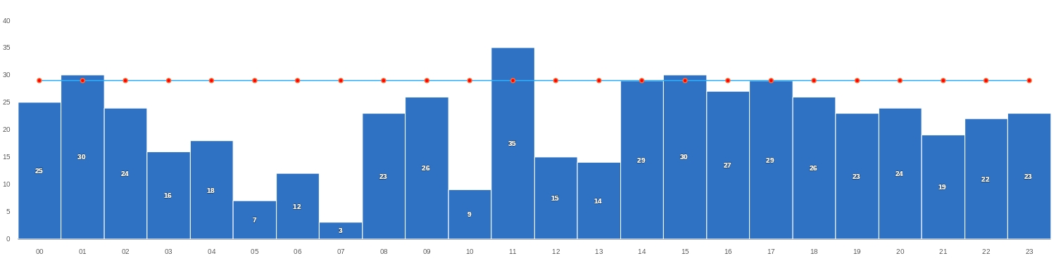
18/07/2024
SCEL
Baixa
Mañana | Tarde | Noche
TAF SCEL 171035Z 1712/1812 VRB02KT 6000 NSC TX19/1719Z TN02/1810Z TEMPO 1712/1714 03004KT 4000 HZ BECMG 1716/1718 18009KT 8000 BECMG 1801/1803 VRB02KT BECMG 1808/1810 15007KT CAVOK
SCEL - RWY 17L/35R INCREASED BIRD HAZARD (MODERATE TO SEVERE) start: 2024-04-25T16:16:00.000Z - End: 2024-07-26T12:30:00.000Z
SCEL - DECLARED CAPACITY OF RWY 17L/17R ACCORDING TO REF AIP CHILE VOL I PAGE ENR 1.9-15 BY DISPLACED THR 17R TEMPO RWY18 AIP VOL II SUP AIP S04/24. CREATED: 15 Apr 2024 23:16:00 SOURCE: SCSCYNYX start: 2024-04-29T13:00:00.000Z - End: 2024-07-29T23:59:00.000Z
SCEL - DURING THE PERIOD OF OPS ON TEMPO RWY 18, PUBLISHED SID FM RWY 17R WILL BE APPLICABLE TO RWY 18. CREATED: 15 Apr 2024 20:30:00 SOURCE: SCSCYNYX start: 2024-04-29T13:00:00.000Z - End: 2024-07-29T23:59:00.000Z
SCEL - POSS DELAY UPON ARRIVALS AND DEPARTURES DUE TO RWY USE RESTRICTIONS CREATED: 29 Apr 2024 18:30:00 SOURCE: SCSCYNYX start: 2024-04-30T00:00:00.000Z - End: 2024-07-29T23:59:00.000Z

Slide 3
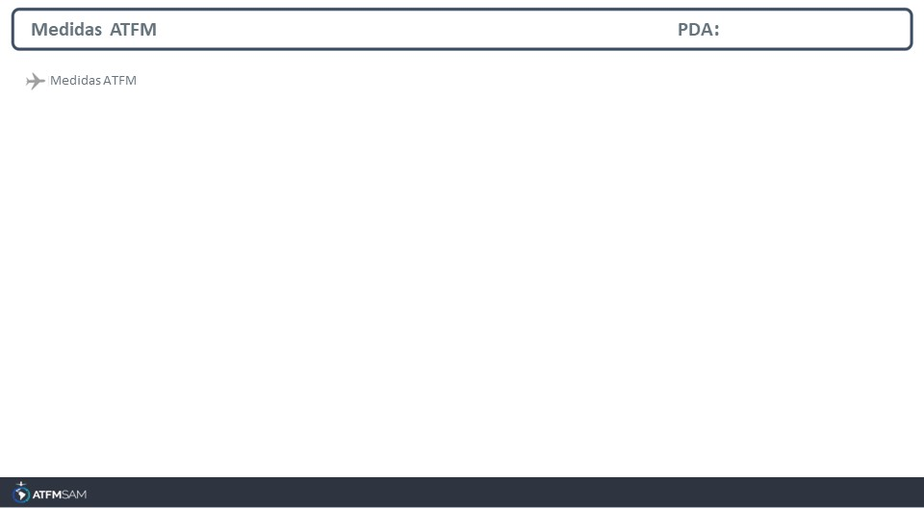
STATE | ORIGIN | DESTINY | ER | START | MEASURE | REASON

Slide 4
