Slide 1
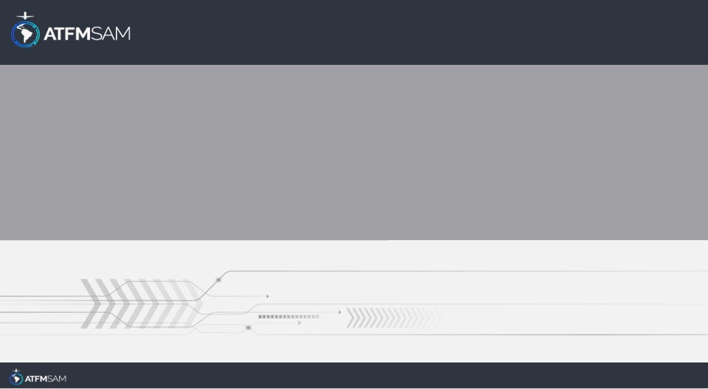
PDA - CHILE 17/06/2025

Slide 2
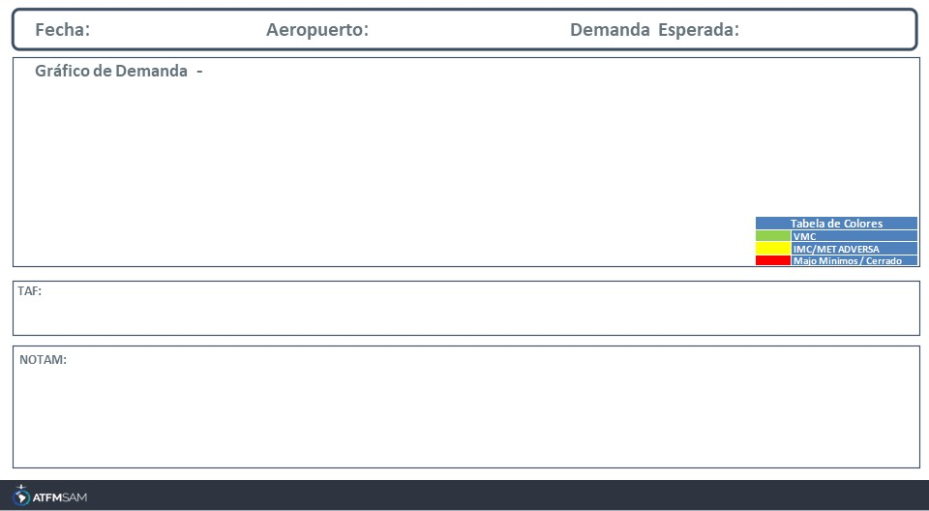
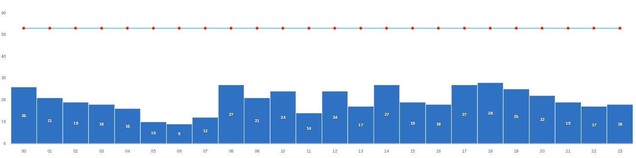
17/06/2025
SCEL
BAJA
Mañana | Tarde | Noche
TAF SCEL 161000Z 1612/1712 16005KT 7000 RA SCT010 BKN020 OVC050 TX12/1619Z TN04/1710Z BECMG 1615/1617 9999 NSW SCT040 TEMPO 1621/1700 20010KT CAVOK BECMG 1700/1702 VRB02KT
SCEL - RWY 17R/35L CLSD, EXC LVP IS ACT CREATED: 28 May 2025 16:15:00 SOURCE: SCSCYNYX start: 2025-06-18T13:00:00.000Z - End: 2025-06-18T17:00:00.000Z SCEL - RWY 17R/35L CLSD, EXC LVP IS ACT CREATED: 28 May 2025 16:36:00 SOURCE: SCSCYNYX start: 2025-06-25T13:00:00.000Z - End: 2025-06-25T17:00:00.000Z

Slide 3
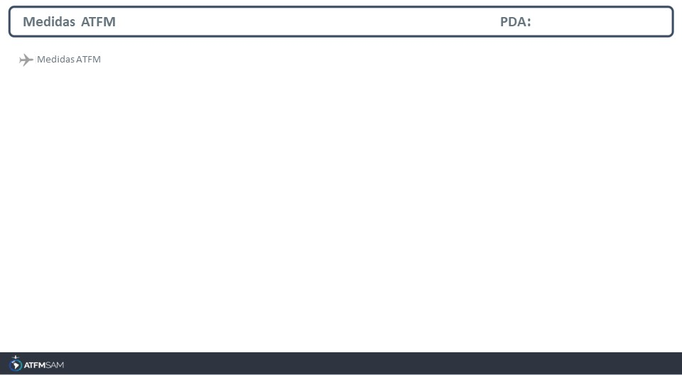
STATE | ORIGIN | DESTINY | ER | START | MEASURE | REASON
CHILE | SAEZ | SCEL | SCEL | 17/06/2025 - 15:30 | 00:03:00 | RESTRICCIONES DE RWY

Slide 4
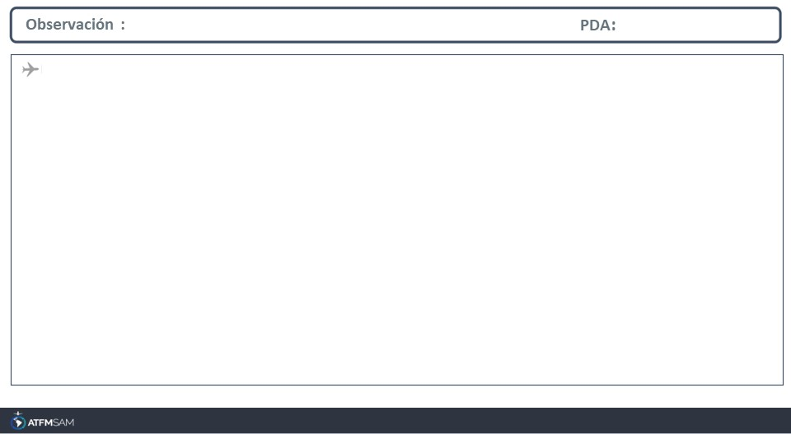
Jmp4

