Slide 1
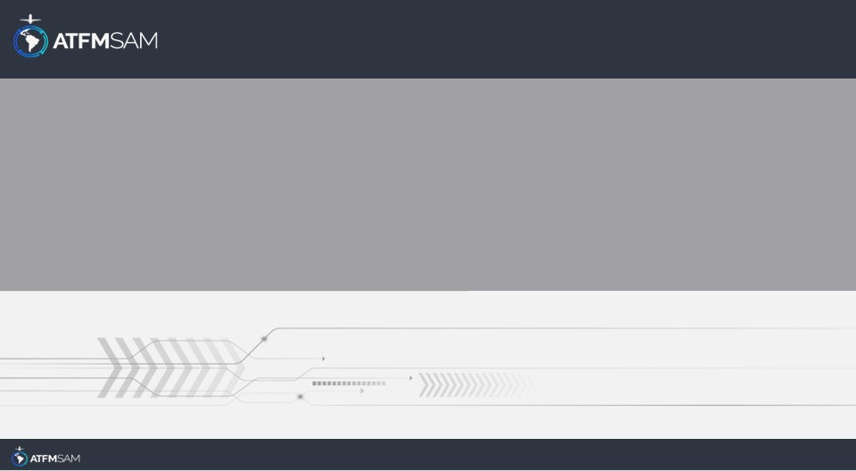
PDA - CHILE 14/08/2024

Slide 2
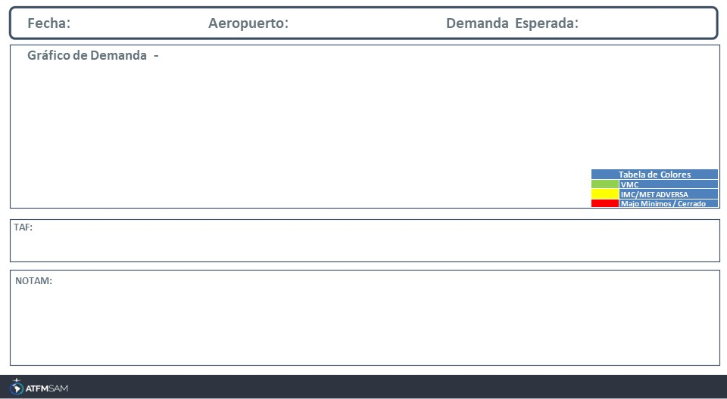
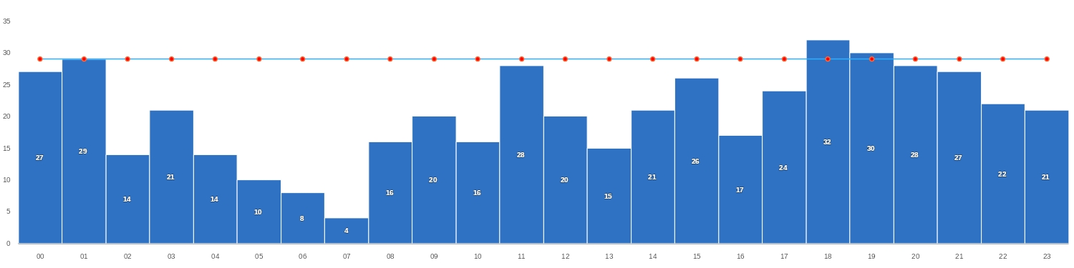
14/08/2024
SCEL
BAJA
Mañana | Tarde | Noche
TAF SCEL 131000Z 1312/1412 VRB02KT 6000 NSC TX22/1319Z TN09/1410Z BECMG 1315/1317 17009KT CAVOK BECMG 1400/1402 16004KT TEMPO 1408/1412 3000 BR SCT008

Slide 3
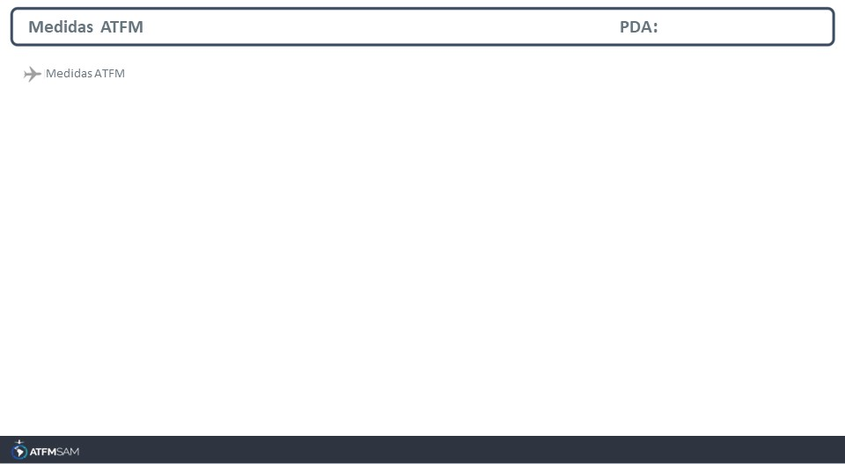
STATE | ORIGIN | DESTINY | ER | START | MEASURE | REASON

Slide 4
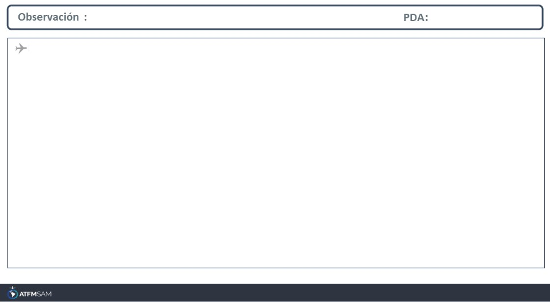
FMU-CHILE Avda. San Pablo 8381, Pudahuel. Santiago - Chile EMAIL: fmu-chile@dgac.gob.cl AMHS: SCLPATFM - SCLPFMUA REDDIG ADM: 404034 - 404793 REDDIG ATS: 4014 Tel: ( 56 2) 2 4392000 extensión 4034 - 4793

