Slide 1
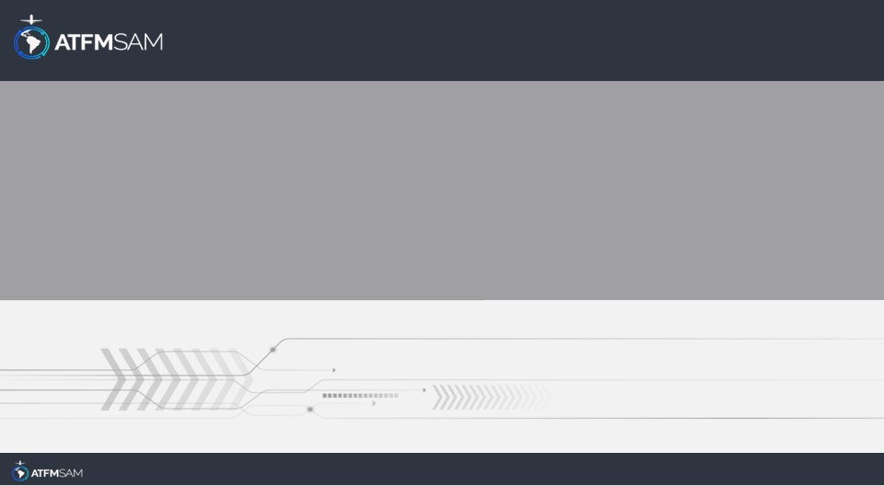
PDA - CHILE 13/12/2025

Slide 2
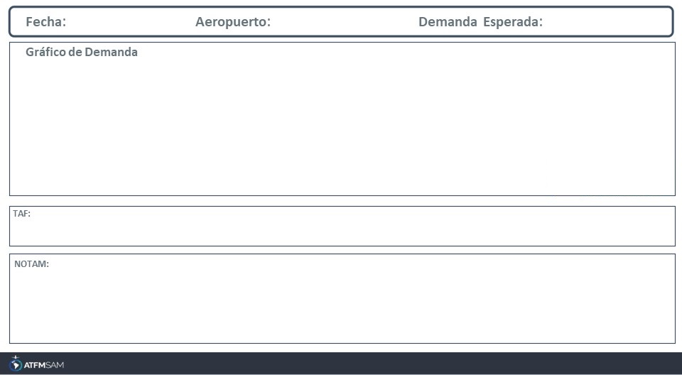
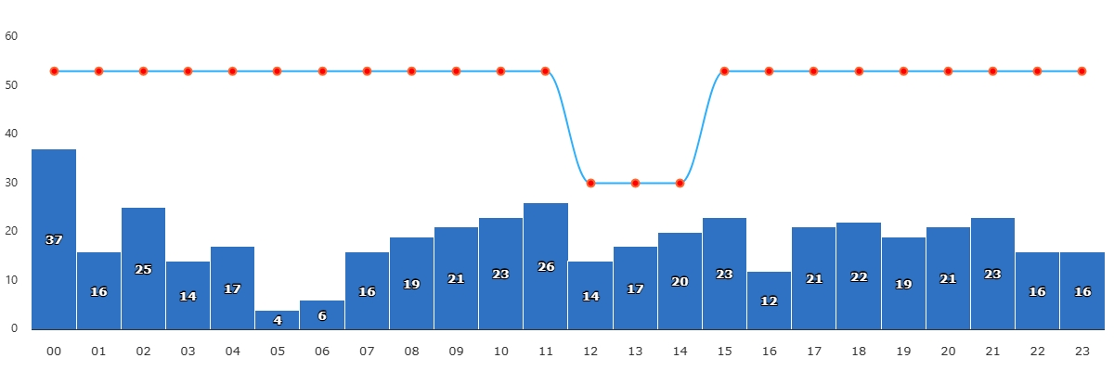
13/12/2025
SCEL
BAJA
VMC
IMC/MET adversa
Majo mínimos / Cerrado
TAF SCEL 121033Z 1212/1312 15004KT 9999 BKN015 BKN020 TX27/1219Z TN13/1310Z BECMG 1214/1216 SCT020 BECMG 1216/1218 21016KT CAVOK BECMG 1302/1304 15004KT

Slide 3
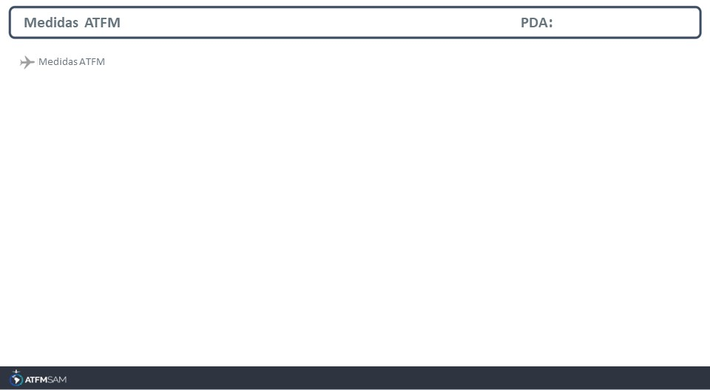
STATE | ORIGIN | DESTINY | ER | START | MEASURE | REASON

Slide 4
