Slide 1
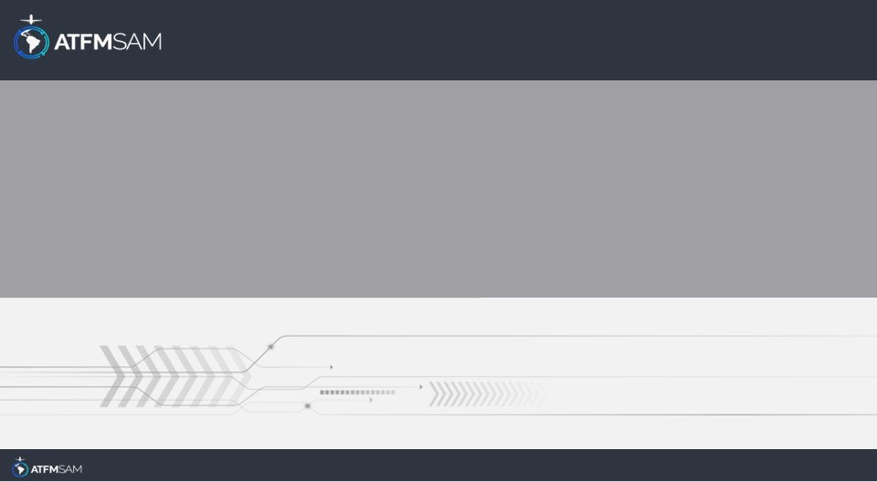
PDA - CHILE 13/06/2025

Slide 2
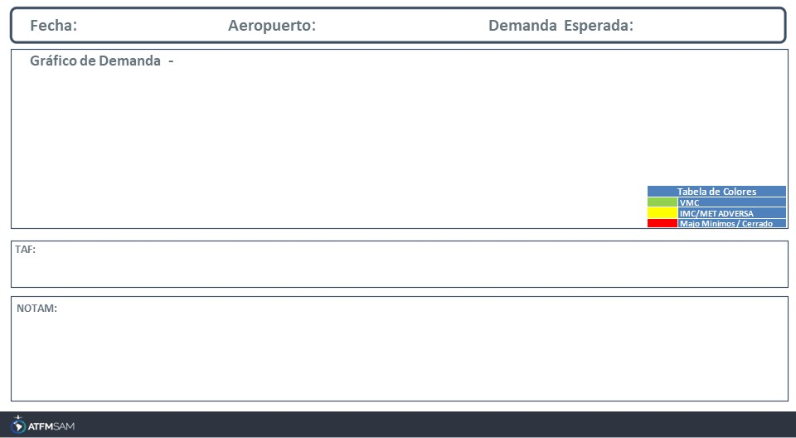
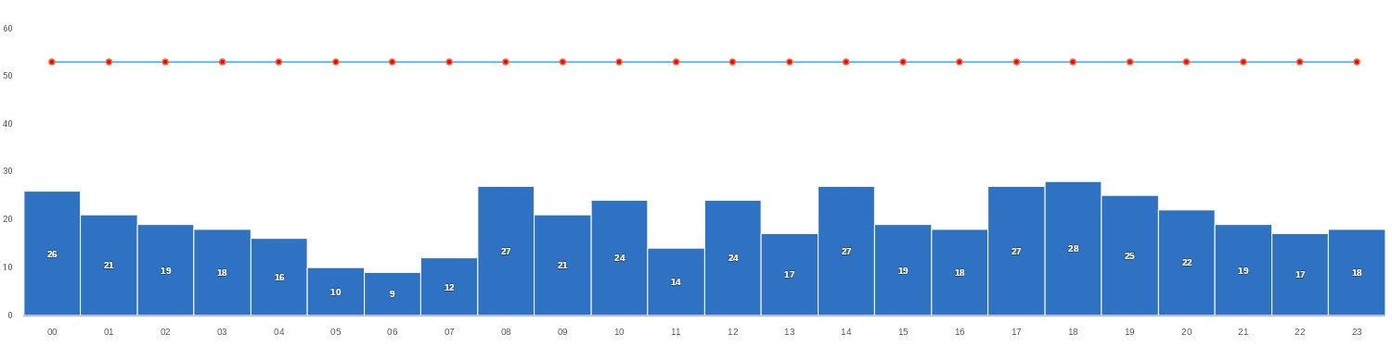
13/06/2025
SCEL
BAJA
Mañana | Tarde | Noche
TAF COR SCEL 121638Z 1218/1318 35010KT 9999 FEW015 BKN050 BKN080 TX10/1219Z TN01/1308Z BECMG 1301/1303 VRB02KT SCT030 SCT100 TEMPO 1308/1312 5000 BR FEW030 BECMG 1315/1317 19008KT FEW050

Slide 3
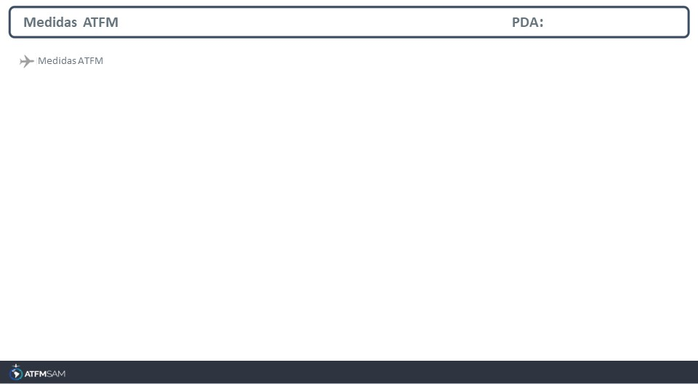
STATE | ORIGIN | DESTINY | ER | START | MEASURE | REASON
CHILE | SCEL | SCEL | SCEL | 13/06/2025 - 15:30 | 00:03:00 | RESTRICCIONES DE RWY

Slide 4
