Slide 1

PDA - CHILE 11/09/2024

Slide 2
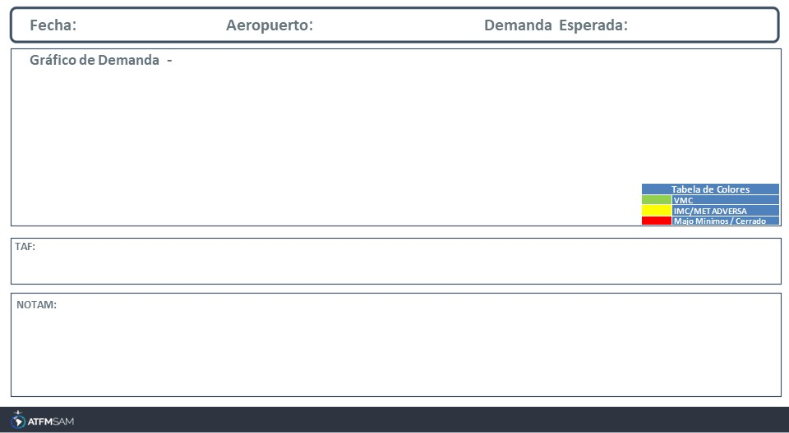
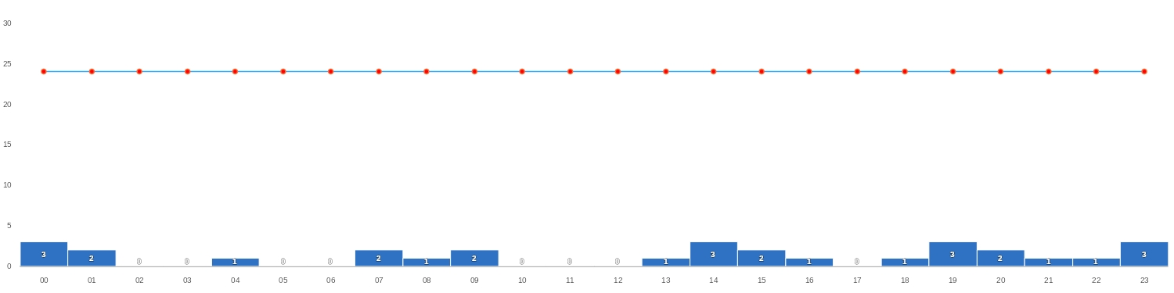
11/09/2024
SCDA
BAJA
Mañana | Tarde | Noche
TAF SCDA 101014Z 1012/1112 21004KT 9999 BKN025 TX17/1018Z TN15/1110Z BECMG 1014/1016 29010KT FEW025 BECMG 1018/1020 OVC025 BECMG 1023/1101 35004KT

Slide 3
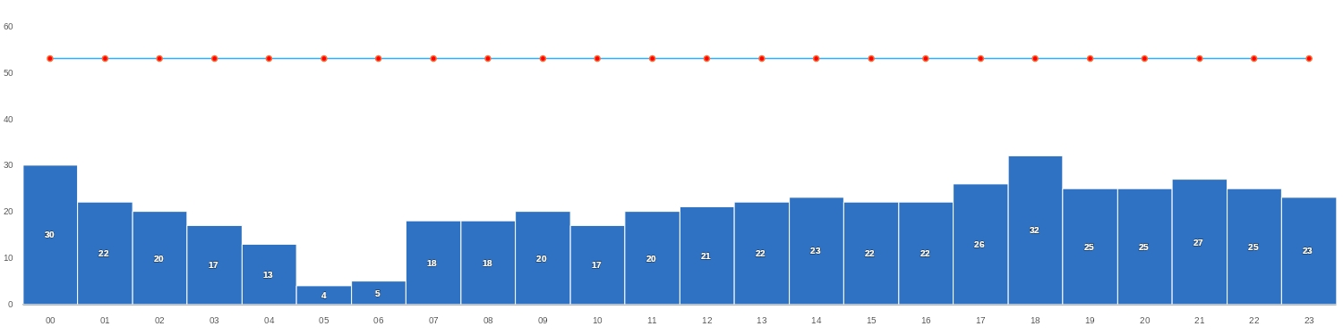
11/09/2024
SCEL
BAJA
Mañana | Tarde | Noche
TAF SCEL 101000Z 1012/1112 VRB02KT CAVOK TX19/1019Z TN08/1110Z BECMG 1014/1016 19010KT BECMG 1019/1021 FEW040 SCT080 BECMG 1100/1102 15004KT SCT030 BKN050 TEMPO 1103/1106 8000 -SHRA BECMG 1107/1109 VRB02KT 7000 FEW035

Slide 4
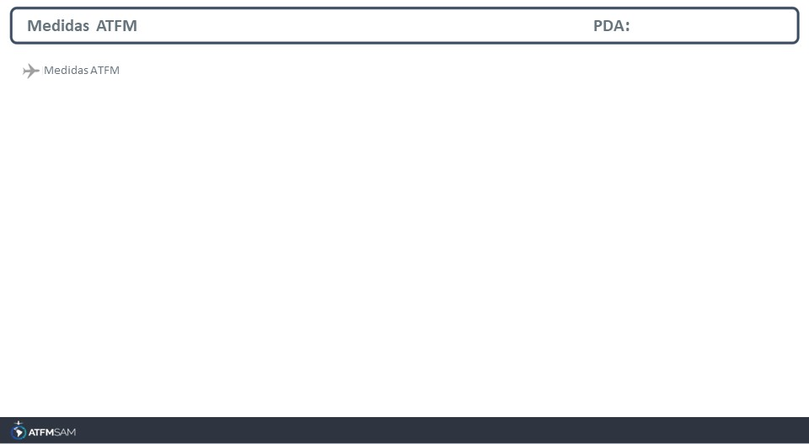
STATE | ORIGIN | DESTINY | ER | START | MEASURE | REASON

Slide 5
