Slide 1

PDA - BRAZIL
15/03/2025

Slide 2
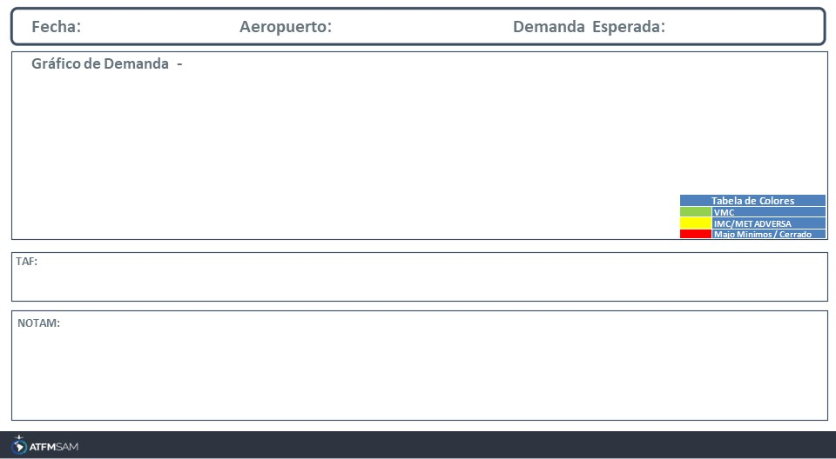
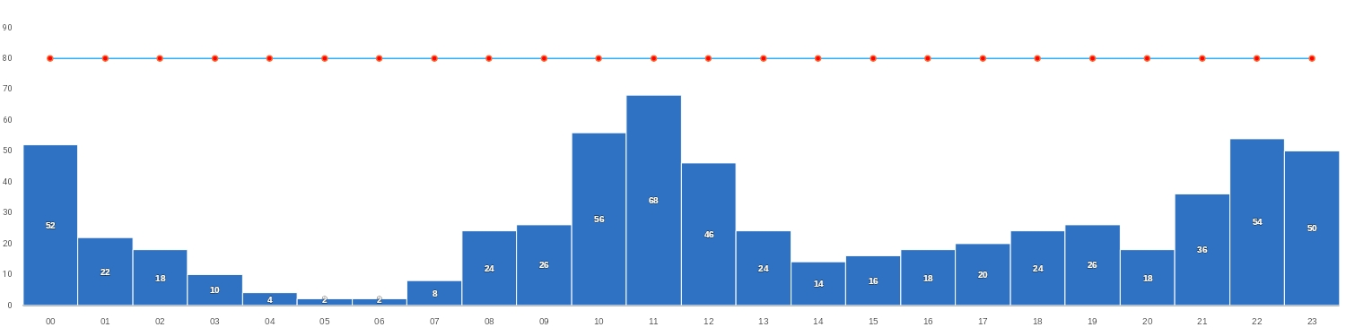
15/03/2025
SBBR
BAJA
Mañana | Tarde | Noche
TAF SBBR 140800Z 1412/1512 14006KT 9999 FEW040 TX32/1418Z TN21/1509Z BECMG 1415/1417 10006KT SCT035 FEW040TCU TEMPO 1419/1422 15010KT TS SCT040 FEW045CB BECMG 1500/1502 22004KT RA SCT030 BECMG 1502/1504 23004KT NSW FEW040 BECMG 1506/1508 16004KT RMK PHG

Slide 3
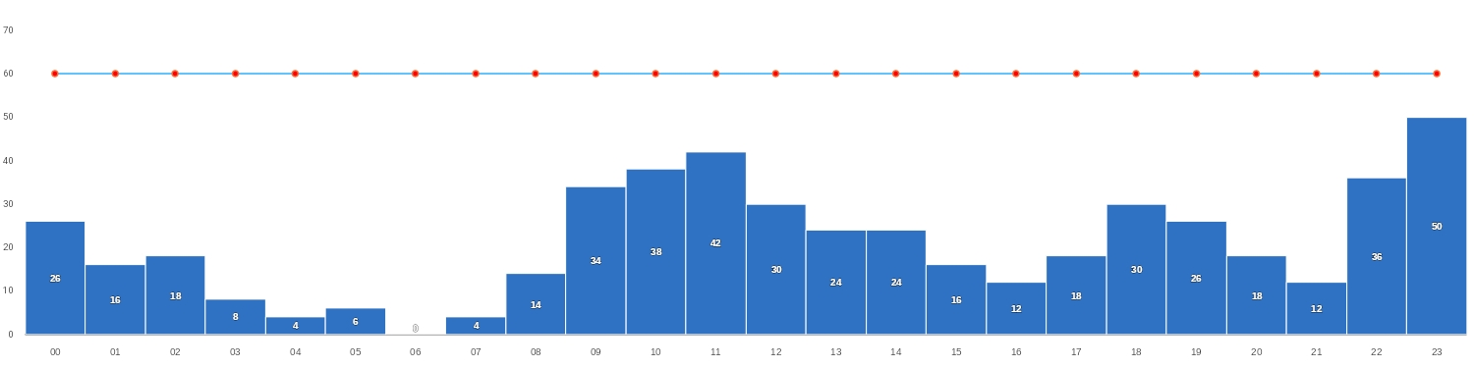
15/03/2025
SBGL
BAJA
Mañana | Tarde | Noche
TAF SBGL 140825Z 1412/1518 20015KT 8000 SCT023 TX30/1417Z TN25/1509Z BECMG 1416/1418 7000 BKN023 FEW033TCU TEMPO 1418/1422 25015KT 4500 TSRA BKN017 FEW030CB BECMG 1422/1424 30006KT 9999 FEW020 BECMG 1507/1510 25006KT 6000 SCT010 BKN017 BECMG 1513/1516 21016KT 8000 BKN020 FEW030TCU RMK PGB

Slide 4
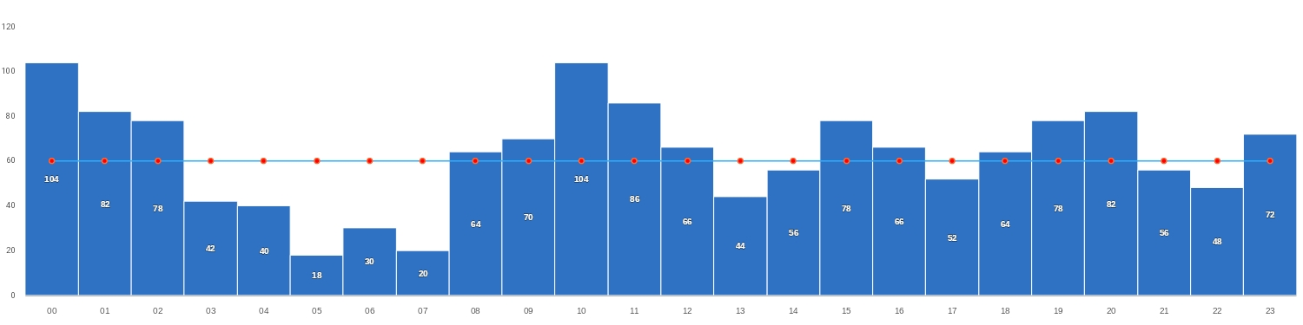
15/03/2025
SBGR
BAJA
Mañana | Tarde | Noche
TAF SBGR 140800Z 1412/1518 08005KT 9999 SCT011 TX29/1417Z TN21/1509Z BECMG 1412/1415 24005KT SCT040 BECMG 1416/1418 19008KT 8000 SCT040 FEW050TCU PROB30 TEMPO 1418/1421 6000 RA BKN040 BECMG 1421/1423 13003KT 8000 NSC BECMG 1511/1513 15008KT SCT040 PROB30 1517/1518 6000 RA BKN030 FEW045TCU RMK PGE

Slide 5
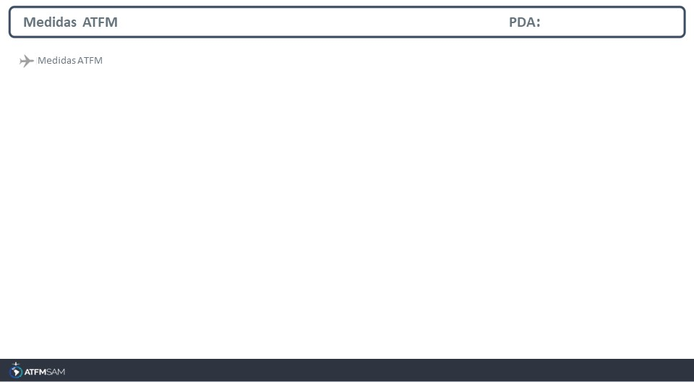
STATE | ORIGIN | DESTINY | ER | START | MEASURE | REASON

Slide 6
