Slide 1

PDA - ARGENTINA
17/09/2025

Slide 2
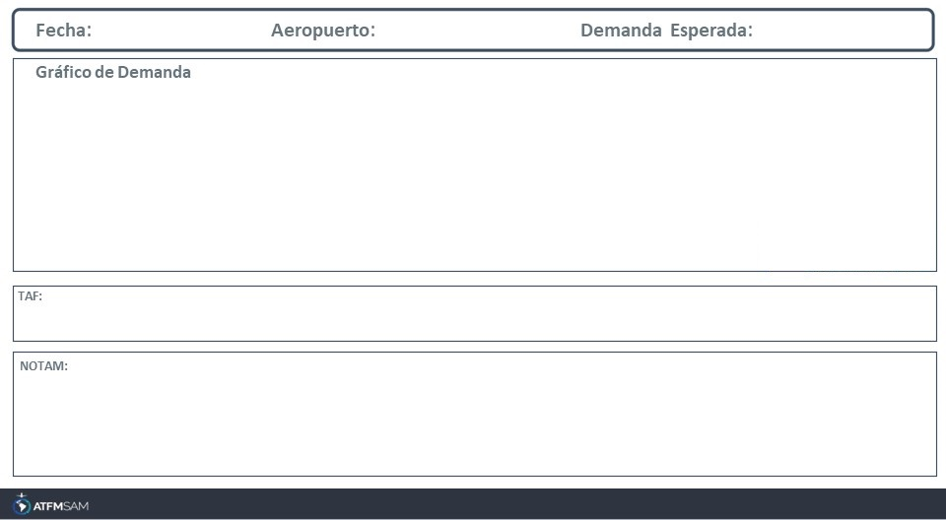
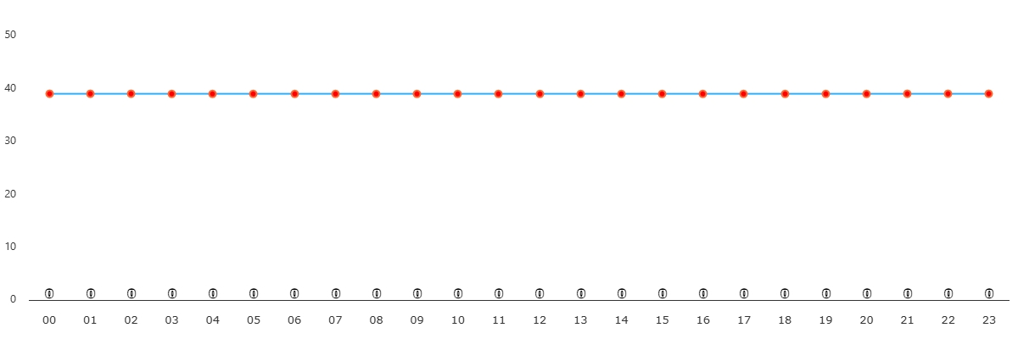
17/09/2025
SABE
BAJA
VMC
IMC/MET adversa
Majo mínimos / Cerrado

Slide 3
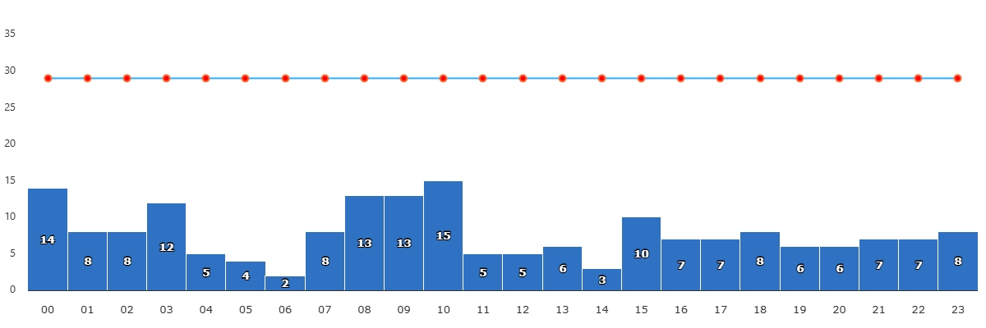
17/09/2025
SAEZ
BAJA
VMC
IMC/MET adversa
Majo mínimos / Cerrado
TAF SAEZ 161700Z 1618/1718 05005KT CAVOK TX26/1718Z TN12/1710Z BECMG 1702/1704 05005KT 5000 BR BKN010 TEMPO 1706/1710 0500 FG BKN005 BECMG 1713/1714 02010KT CAVOK

Slide 4
17/09/2025
SAEZ
BAJA
VMC
IMC/MET adversa
Majo mínimos / Cerrado
TAF SAEZ 161700Z 1618/1718 05005KT CAVOK TX26/1718Z TN12/1710Z BECMG 1702/1704 05005KT 5000 BR BKN010 TEMPO 1706/1710 0500 FG BKN005 BECMG 1713/1714 02010KT CAVOK

Slide 5
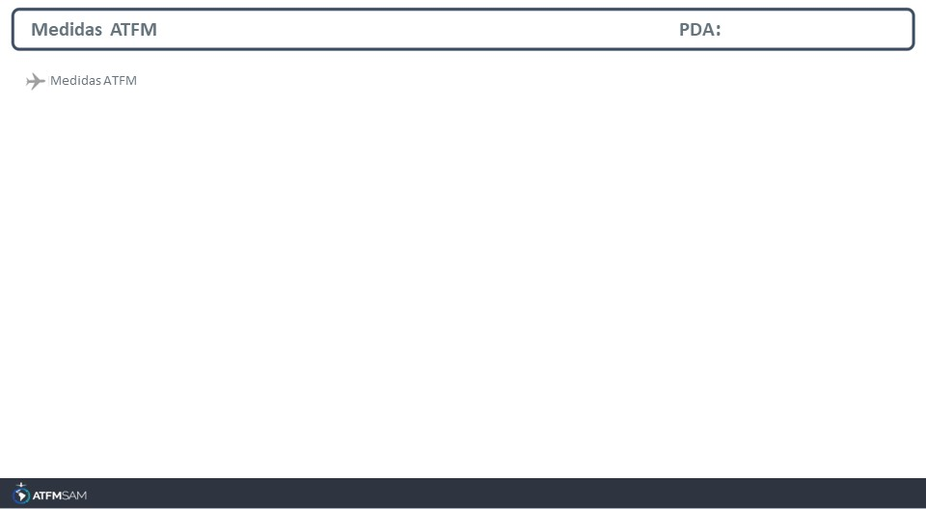
STATE | ORIGIN | DESTINY | ER | START | MEASURE | REASON

Slide 6
