Slide 1

PDA - ARGENTINA
08/08/2024

Slide 2
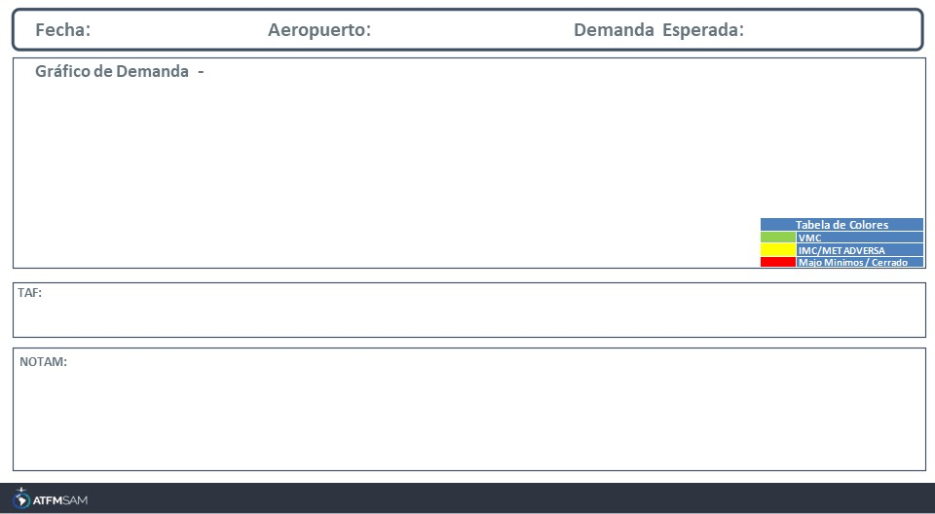
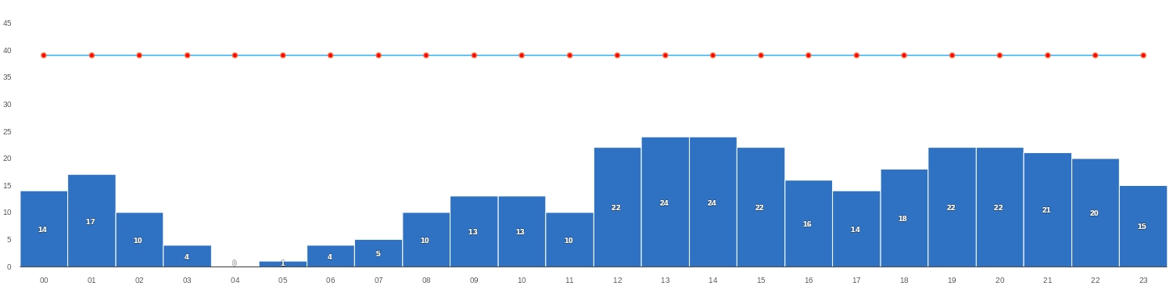
08/08/2024
SABE
BAJA
Mañana | Tarde | Noche
TAF SABE 070500Z 0706/0806 24010KT CAVOK TX15/0718Z TN11/0711Z BECMG 0712/0714 25015G25KT

Slide 3
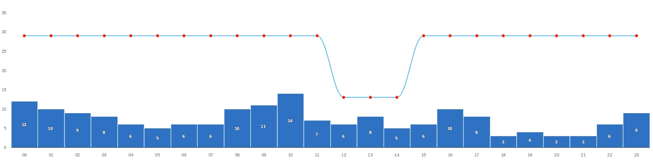
08/08/2024
SAEZ
BAJA
Mañana | Tarde | Noche
TAF SAEZ 070500Z 0706/0806 25010KT CAVOK TX16/0718Z TN09/0710Z PROB30 TEMPO 0708/0711 8000 SCT010 BECMG 0711/0713 24015KT SCT040 SCT200 BECMG 0716/0718 CAVOK BECMG 0802/0804 27012KT
SAEZ - RWY 11/29 CLSD WIP MAINT CREATED: 01 Aug 2024 19:52:00 SOURCE: SAEZYNYX start: 2024-08-05T11:40:00.000Z - End: 2024-08-10T14:40:00.000Z

Slide 4
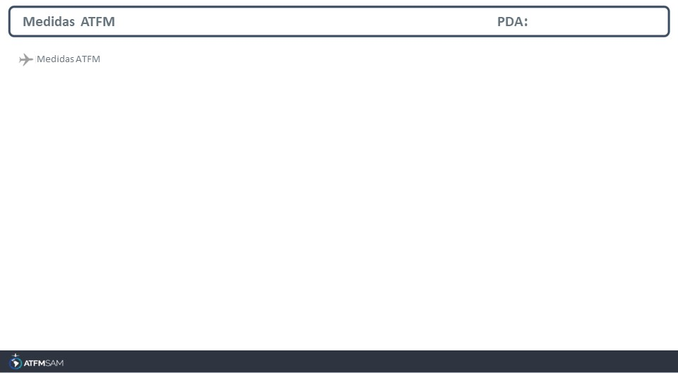
STATE | ORIGIN | DESTINY | ER | START | MEASURE | REASON

Slide 5
